Slide 1
Build Your First Big Data Application on AWS
Ben Willett
Sr. Solutions Architect
Juan Yu
Redshift Specialist Solutions Architect
Sudhir Gupta
Partner Specialist Solutions Architect
Notes:
BW: present 1 – 34, then self-paced workshop

Slide 2
Workshop Agenda
Download this presentation
Apply $25 AWS usage credit to your account (5 mins)
Create AWS resources via CloudFormation (10 mins)
Review application and AWS services used (45 mins)
Build Your First Big Data Application on AWS! (90 mins)
https://github.com/wrbaldwin/da-week

Slide 3
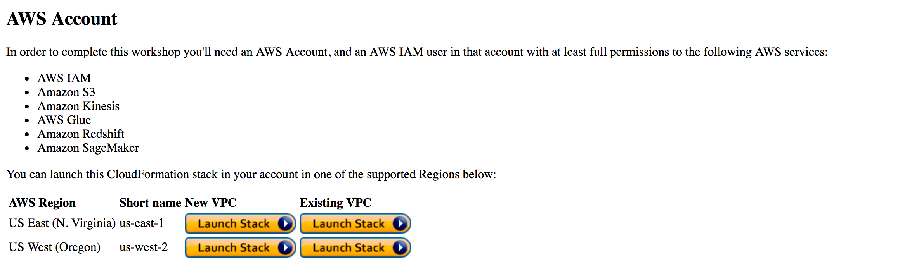
Launch AWS CloudFormation template
Browse to the link below and select New VPC
Select N. Virginia or Oregon or Ireland or Frankfurt for the region to launch your stack.
https://tinyurl.com/y6v2hjuz

Slide 4
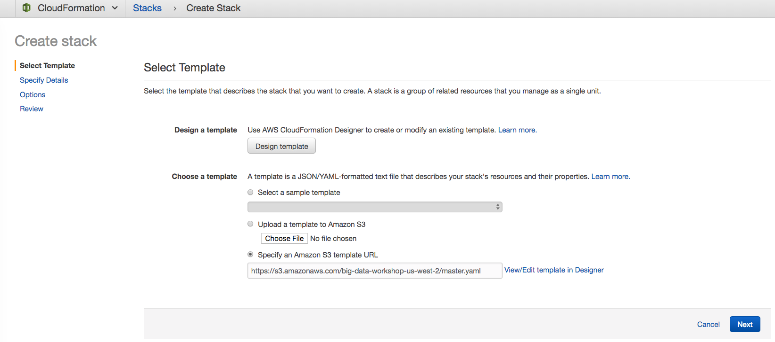
Launch AWS CloudFormation template - Continued
After selecting New or Existing VPC, you will be launched into the AWS CloudFormation service
Verify the Amazon Simple Storage Service (Amazon S3) template URL, and click “Next”

Slide 5
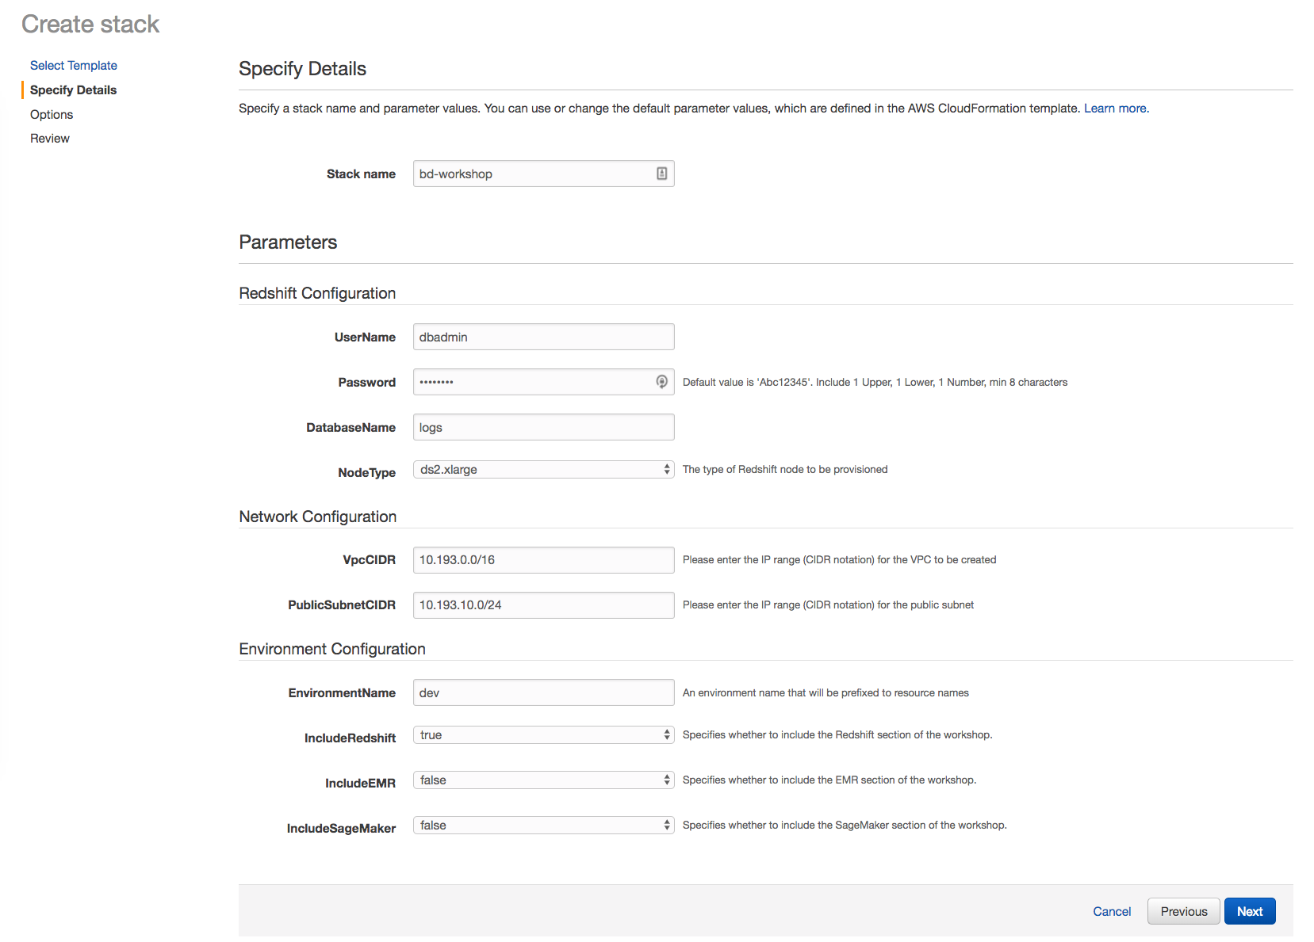
Launch AWS CloudFormation template - Continued
All defaults can be left as-is for this lab. Depending on if you selected new or existing, the only change is picking a CIDR range for the VPC or selecting an existing VPC in your account.
If there is a Amazon Redshift password in there, leave as is.
If there is no password, enter Abc12345 as the password. Make a note of this for later.
Click “Next”

Slide 6
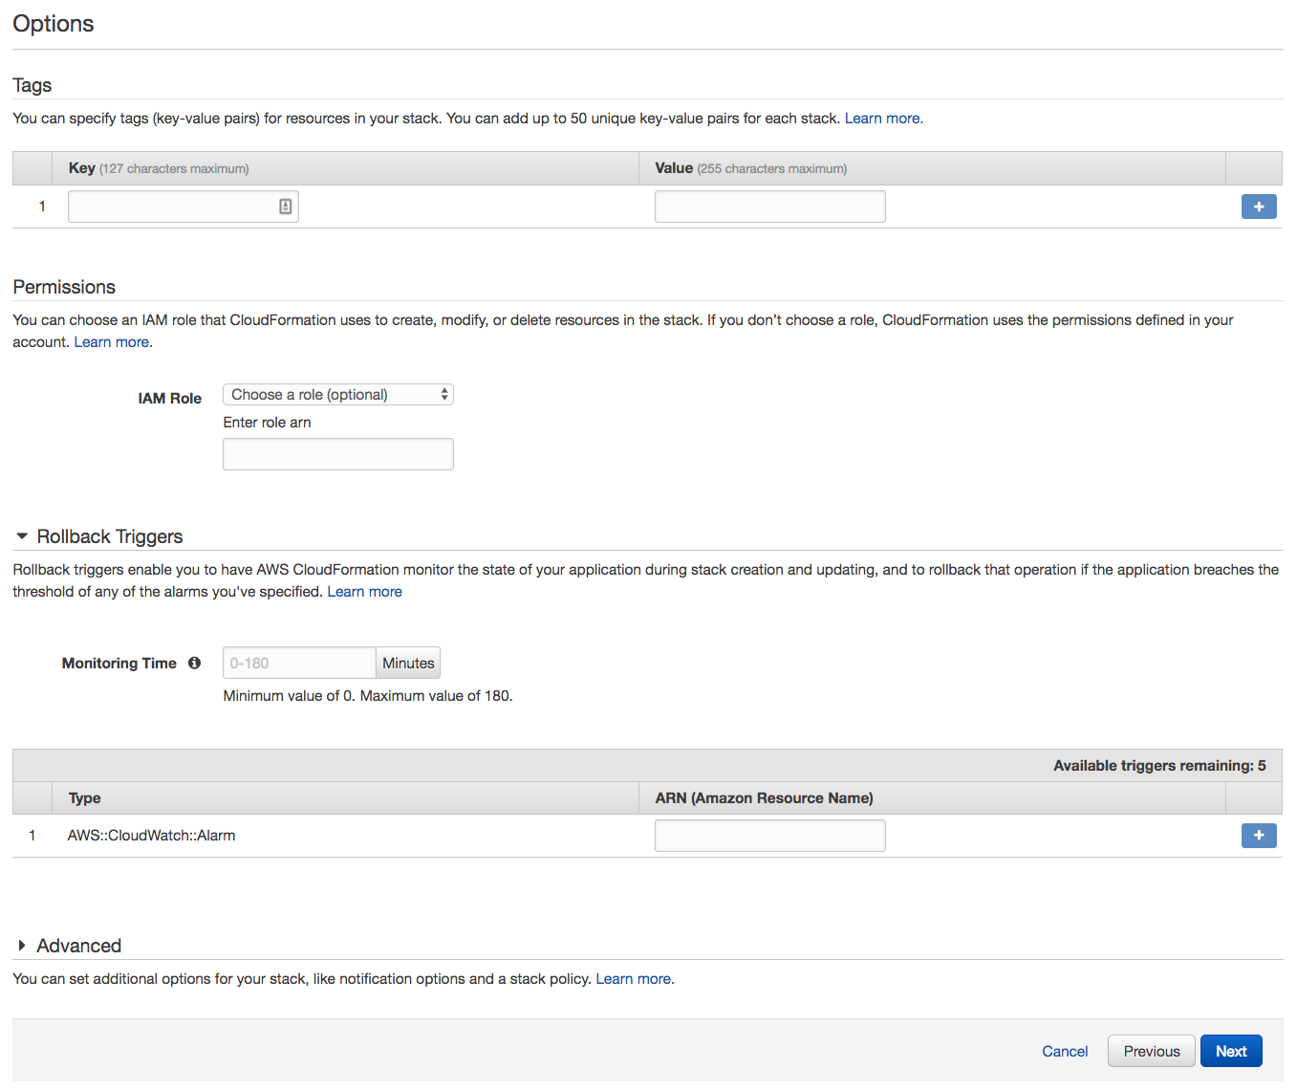
Launch AWS CloudFormation template - Continued
Leave the Options at their defaults and click “Next”.

Slide 7
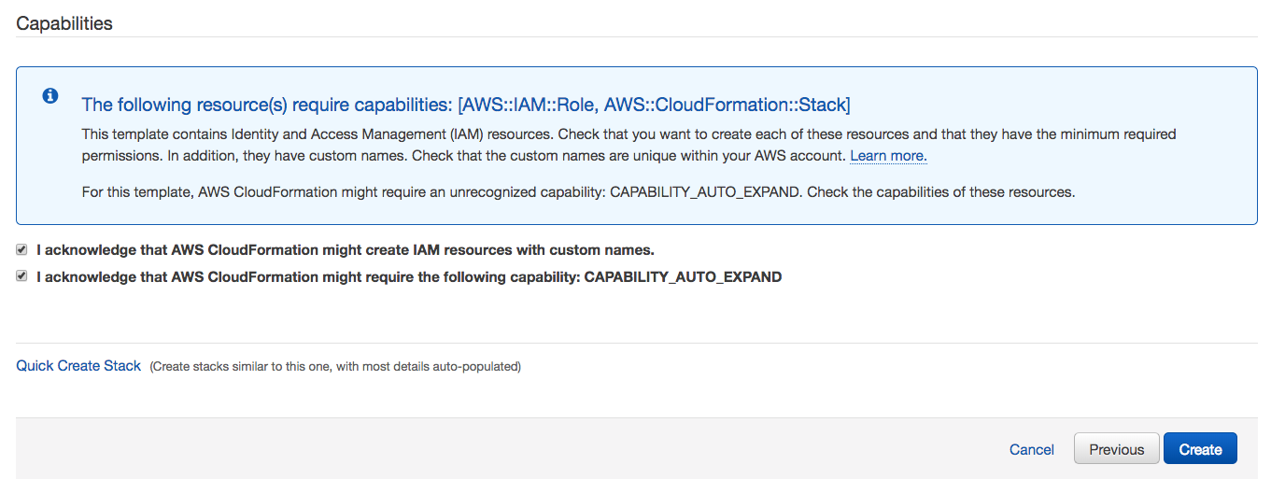
Launch AWS CloudFormation template - Continued
Acknowledge the AWS CloudFormation template will create AWS Identity and Access Management (IAM) resources in your account
Acknowledge the CAPABILITY_AUTO_EXPAND as well.
Click “Create”
Verify the stacks are in “CREATE_IN_PROGRESS“ status.
Wait for all CREATE_COMPLETE (approx. x minutes with EMR & SM)

Slide 8
Workshop objectives
Build an end-to-end analytics application on AWS
Implement batch and real-time layers in a single application
Explore AWS analytics portfolio for other use cases

Slide 9
Why analytics on AWS?
Unmatched durability, and availability at EB scale
Security, compliance and audit capabilities.
Object-level controls for fine-grained
access
Fast performance by retrieving subsets of data
Analyze with broad set of analytics & ML services
Future proof your data lake architecture
Machine
learning
Analytics
Data lake on AWS
Traditional
Real-time data
data movement
movement

Slide 10

















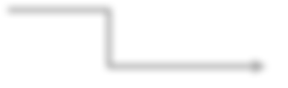

Your application architecture
Process & compute aggregate web log metrics
Deliver processed web logs to Amazon Redshift
Run SQL queries on processed weblogs
Visualize weblogs to discover insights
Generate weblogs
Collect weblogs and deliver to S3
Amazon Kinesis Data Analytics
Amazon Redshift
Amazon QuickSight
Amazon Kinesis Data Firehose
Amazon Athena
Amazon Kinesis Data Streams Producer
Amazon Kinesis Data Firehose
Amazon S3 bucket
AWS Glue
Amazon S3 bucket
Interactive querying of weblogs
Raw weblogs from Kinesis Data Firehose
Extract metadata, create tables and transform weblogs from CSV to parquet
Transformed weblogs from AWS Glue
Amazon EMR
Interactive analysis of weblogs

Slide 11
Streaming ingest with
Amazon Kinesis

Slide 12
Streaming with Amazon Kinesis Easily collect, process, and analyze video and data streams in real time
SQL
Kinesis Video Streams
Kinesis Data Streams
Kinesis Data Firehose
Kinesis Data Analytics
Capture, process, and store video streams
Capture, process, and store data streams
Load data streams into data stores
Analyze data streams with SQL

Slide 13
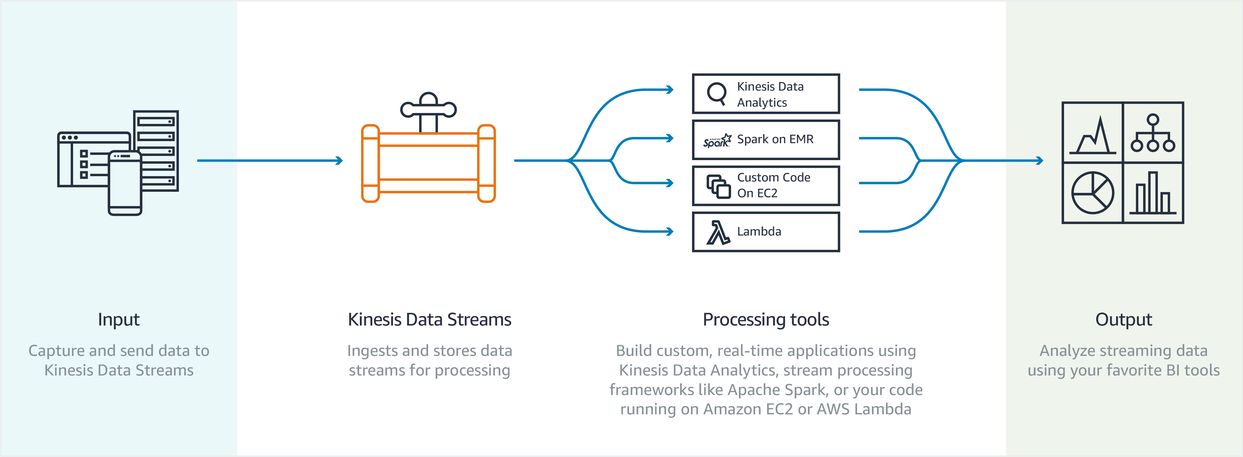
Amazon Kinesis Data Streams
Easy administration and low cost
Build real-time applications with framework of choice
Secure, durable storage

Slide 14
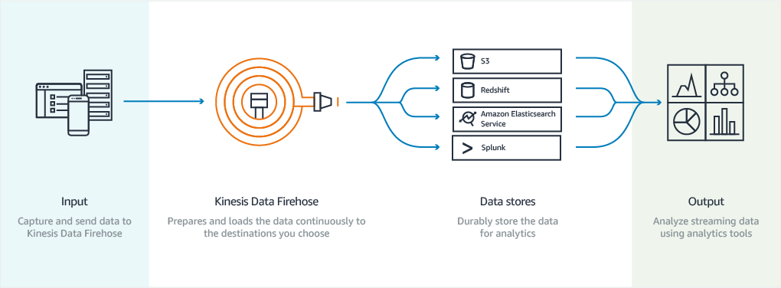
Amazon Kinesis Data Firehose
Zero administration and seamless elasticity
Direct-to-data store integration
Serverless, continuous data transformations

Slide 15
Amazon Kinesis - Firehose vs. Streams
Amazon Kinesis Data Streams is for use cases that require custom processing, per incoming record, with sub-1 second processing latency, and a choice of stream processing frameworks
Amazon Kinesis Data Firehose is for use cases that require zero administration, ability to use existing analytics tools based on Amazon S3, Amazon Redshift, and Amazon ES, and a data latency of 60 seconds or higher
Kinesis Data
Streams
Kinesis Data
Firehose

Slide 16
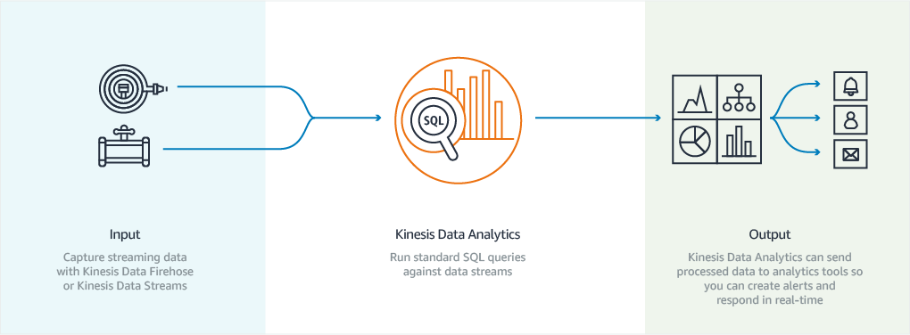
Amazon Kinesis Data Analytics
Powerful real-time applications
Easy to use, fully managed
Automatic elasticity
Windowed aggregations

Slide 17
Kinesis Data Analytics applications
1011101
1011010
0101010
Connect to streaming source
Easily write SQL code to process streaming data
Continuously deliver SQL results
1011101
1011010
0101010

Slide 18
Kinesis Data Analytics application metadata
Note that Amazon Kinesis adds metadata to each record being sent, which was shown in the formatted record sample:
The ROWTIME represents the time when the Kinesis application inserts a row in the first in-application stream. It’s a special column used for time series analytics. This is also known as the processing time.
The APPROXIMATE_ARRIVAL_TIME is the time the record was added to the streaming source. This is also known as ingest time or server-side time.
The Event Time is the timestamp when the event occurred. It’s a also called client side time. Its useful because it’s the time when an event occurred at the client.

Slide 19
Calculate an aggregate metric
Tumbling
Fixed size and non-overlapping
Use FLOOR() or STEP() function in a GROUP BY statement
Sliding
Fixed size and overlapping; row boundaries are determined when new rows enter window
Use standard OVER and WINDOW clause
Custom
Not fixed size and overlapping; row boundaries by conditions
Implementations vary, but typically require two steps (Step 1— identify boundaries, Step 2—perform computation)
Stagger
Not fixed size and non-overlapping; windows open when the first event matching the partition key arrives
Use WINDOWED BY STAGGER and PARTITION BY statements

Slide 20
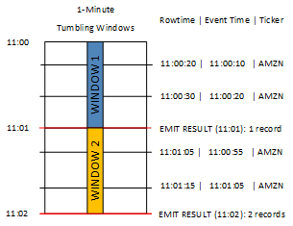
Calculate an aggregate metric
Limitations of Tumbling Windows—aggregating late or out-of-order data.
GROUP BY ticker_symbol, FLOOR(EVENT_TIME TO MINUTE), STEP("SOURCE_SQL_STREAM_001".ROWTIME BY INTERVAL '1' MINUTE);
Input events
ROWTIME | EVENT_TIME | TICKER_SYM
11:00:20 | 11:00:10 | AMZN
11:00:30 | 11:00:20 | AMZN
11:01:05 | 11:00:55 | AMZN
11:01:15 | 11:01:05 | AMZN
Tumbling Window result
ROWTIME | EVENT_TIME | TICKER_SYM | COUNT
11:01:00 | 11:00:00 | AMZN | 2
11:02:00 | 11:00:00 | AMZN | 1
11:02:00 | 11:01:00 | AMZN | 1

Slide 21
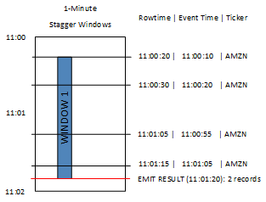
Calculate an aggregate metric
Stagger Windows - great at aggregating late or out-of-order data
WINDOWED BY STAGGER (
PARTITION BY FLOOR(EVENT_TIME TO MINUTE), TICKER_SYMBOL RANGE INTERVAL '1' MINUTE);
Input events
ROWTIME | EVENT_TIME | TICKER_SYM
11:00:20 | 11:00:10 | AMZN
11:00:30 | 11:00:20 | AMZN
11:01:05 | 11:00:55 | AMZN
11:01:15 | 11:01:05 | AMZN
Stagger Window result
ROWTIME | EVENT_TIME | TICKER_SYM | Count
11:01:20 | 11:00:00 | AMZN | 3
11:02:15 | 11:01:00 | AMZN | 1

Slide 22
Extract, Transform, and Load (ETL) with AWS Glue

Slide 23
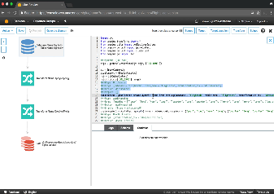

AWS Glue - Components Make data discoverable
Data Catalog
ETL Job authoring
Automatically discovers data and stores schema
Catalog makes data searchable and available for ETL
Catalog contains table and job definitions
Computes statistics to make queries efficient
Discover data and extract schema
Auto-generates customizable ETL code in Python and Spark

Slide 24
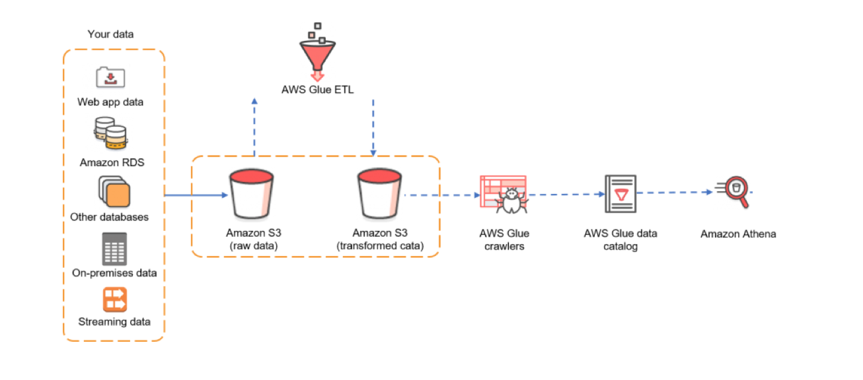
AWS Glue - How it works

Slide 25
Querying data in Amazon S3
with Amazon Athena and
Amazon Redshift Spectrum

Slide 26
Interactive query service
Query directly from Amazon S3
Use ANSI SQL
Serverless
Multiple data formats
Cost-effective
Amazon Athena

Slide 27


Familiar technologies under the covers
Used for SQL queries
In-memory distributed query engine ANSI-SQL compatible with extensions
Used for DDL functionality Complex data types
Multitude of formats Supports data partitioning

Slide 28
Comparing performance and cost savings for compression and columnar format
Size on
Dataset
Query run time
Data scanned
Cost
Amazon S3
Data stored as text files |  | 236 seconds | 1.15 TB | $5.75
Data stored in Apache parquet 130 GB |  | 6.78 seconds | 2.51 GB | $0.013
format*
Savings / | 87% less with _{34x faster} 99% less data _{99.7% savings}
Speedup | parquet | scanned
1 TB
(*compressed using Snappy compression)
https://aws.amazon.com/blogs/big-data/analyzing-data-in-s3-using-amazon-athena/

Slide 29

Amazon Redshift Spectrum Extend the data warehouse to your Amazon S3 data lake
Scale compute and storage separately
Join data across Amazon Redshift and Amazon S3
Amazon Redshift SQL queries against exabytes in Amazon S3
Stable query performance and unlimited concurrency
Parquet, ORC, Grok, Avro, & CSV data formats
Pay only for the amount of data scanned
Amazon Redshift Spectrum query engine
Amazon Redshift data
Amazon S3 data lake

Slide 30
Defining external schema and creating tables
Define an external schema in Amazon Redshift using the Athena data catalog or your own Apache Hive Metastore
CREATE EXTERNAL SCHEMA <schema_name>
Query external tables using <schema_name>.<table_name>
Register external tables using AWS Glue Data Catalog, your Hive Metastore client, or from Amazon Redshift CREATE EXTERNAL TABLE syntax
CREATE EXTERNAL TABLE <table_name>
[PARTITIONED BY <column_name, data_type, …>]
STORED AS file_format
LOCATION s3_location
[TABLE PROPERTIES property_name=property_value, …];

Slide 31
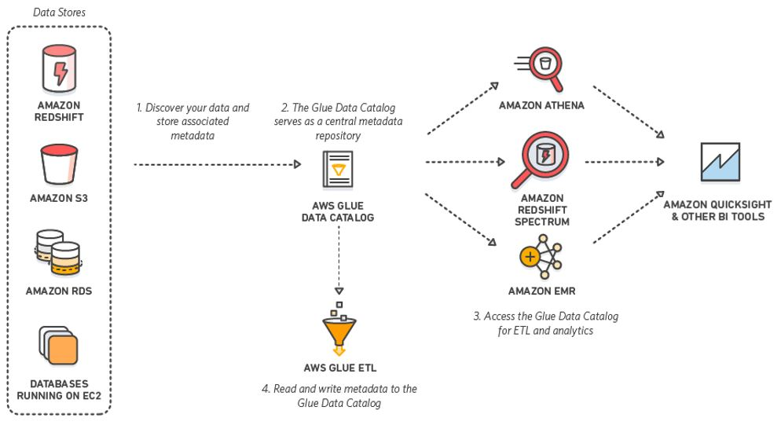
Recap: AWS Glue, Amazon Redshift Spectrum, and Athena
Used the AWS Glue ETL job to convert and place the raw log data to parquet in S3
Used the AWS Glue crawler to extract schema for parquet data in Amazon S3 and place in AWS Glue Data Catalog (weblogs_<environment>.parquet)
Used the Redshift Spectrum external table to query parquet data in Amazon S3 (spectrum.parquet)
Used Athena to run queries on the same parquet data in Amazon S3 (weblogs_<environment>.parquet)
Both Athena and Redshift Spectrum use the same AWS Glue Data Catalog

Slide 32
Workshop activities schedule
First big data app workshop activities:
1: Collect logs with Kinesis Data Firehose delivery stream—5 mins
2: Real-time streaming queries using Kinesis Data Analytics—20 mins
3: Deliver streaming results to Amazon Redshift—5 mins
4: Transform weblogs using AWS Glue—30 mins
5: Query parquet data with Amazon Redshift Spectrum and Athena—30 mins
Total hands-on lab time: 90 mins
Activities have to be completed in sequence
Pace yourself
Helpers are available!

Slide 33
Activity 1 Collect logs using a
Kinesis Data Firehose
delivery stream

Slide 34
Your application architecture
Process & compute aggregate web log metrics
Deliver processed web logs to Amazon Redshift
Run SQL queries on processed weblogs
Visualize weblogs to discover insights
Generate weblogs
Collect weblogs and deliver to S3
Amazon Kinesis Data Analytics
Amazon Redshift
Amazon QuickSight
Amazon Kinesis Data Firehose
Amazon Athena
Kinesis Producer
Amazon Kinesis Data Firehose
Amazon S3 bucket
AWS Glue
Amazon S3 bucket
Interactive querying of weblogs
Raw weblogs from Kinesis Data Firehose
Extract metadata, create tables and transform weblogs from CSV to parquet
Transformed weblogs from AWS Glue
Amazon EMR
Interactive analysis of weblogs

Slide 35
Collect logs w/a Kinesis Data Firehose delivery stream
Time: 5 minutes
We are going to:
Write to a Data Firehose delivery stream—Simulate writing transformed Apache weblogs to a Data Firehose delivery stream that is configured to deliver data into an S3 bucket.
There are many different tools and libraries that can be used to write data to a Data Firehose delivery stream. One popular option is called the Amazon Kinesis Agent.

Slide 36
Collect logs w/a Kinesis Data Firehose delivery stream
So that we don’t have to install or set up software on your machine, we are going to use a Lambda function to simulate using the Amazon Kinesis Agent. The Lambda function can populate a Data Firehose delivery stream using a template and is simple to setup.
Let’s get started!

Slide 37
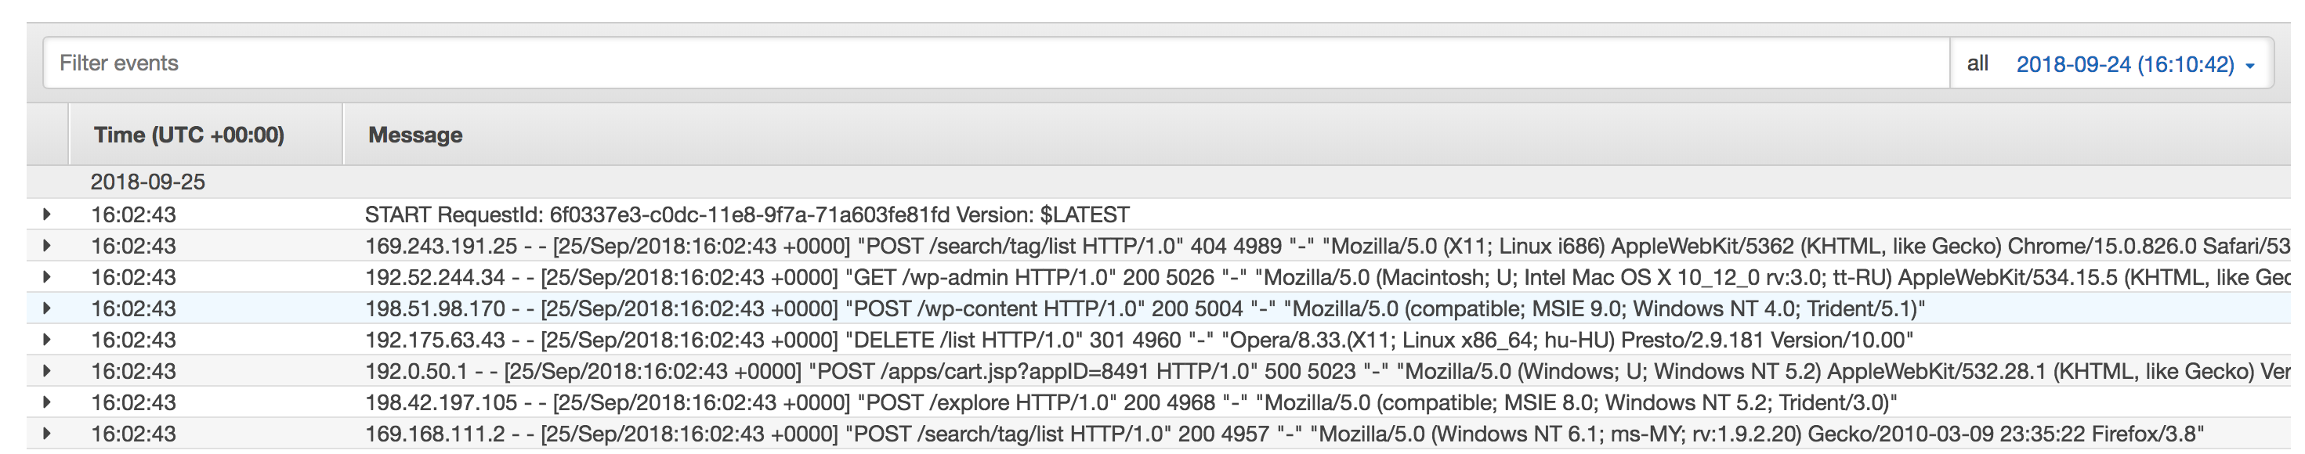
Activity 1A: Verify Lambda function delivering logs
Go to the Lambda console and find a function named like:
<StackName>-KinesisStack-xxx-GenerateLogsLambdaFunc-xxxxxxx
Go to the Monitoring tab and click the “View logs in CloudWatch” button
View the top log stream and you should see Apache log entries like below:

Slide 38
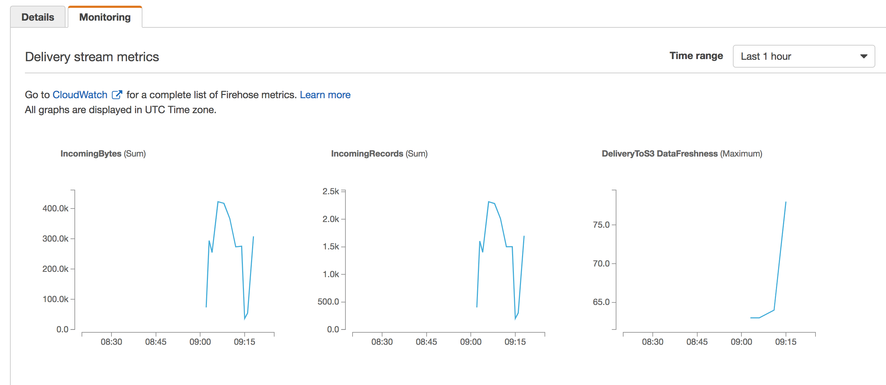
Review: Monitoring Kinesis Data Firehose delivery to Amazon S3
Go to the Kinesis console, click on “Data Firehose” and find data stream named like:
<StackName>-KinesisStack-xxx-FirehoseDeliveryStream-xxxxxxx
Go to the Monitoring tab and there should be metrics for delivery to Amazon S3. This might take some time to show up.

Slide 39
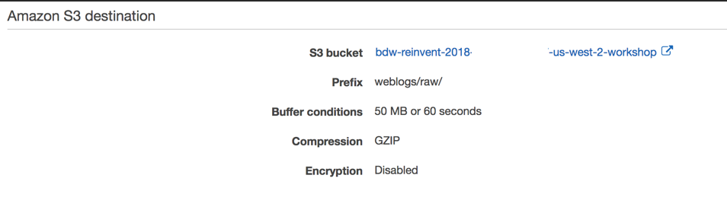
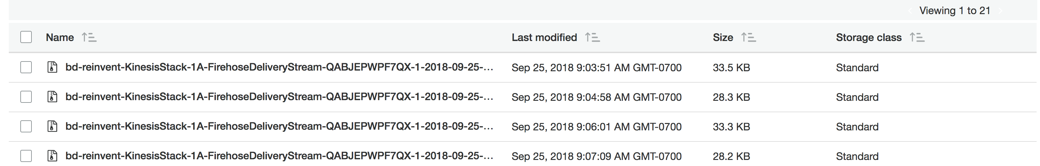
Review: Monitoring Kinesis Data Firehose Delivery to Amazon S3
Go to the Kinesis console and click on “Data Firehose” and find data stream named like:
<StackName>-KinesisStack-xxx-FirehoseDeliveryStream-xxxxxxx
On the details tab you can see the S3 bucket the Apache logs are being streamed to:

Slide 40
Activity 2 Real-time data processing using
Amazon Kinesis Data Analytics

Slide 41
Your application architecture
Process & compute aggregate web log metrics
Deliver processed web logs to Amazon Redshift
Run SQL queries on processed weblogs
Visualize weblogs to discover insights
Generate weblogs
Collect weblogs and deliver to S3
Amazon Kinesis Data Analytics
Amazon Redshift
Amazon QuickSight
Amazon Kinesis Data Firehose
Amazon Athena
Kinesis Producer
Amazon Kinesis Data Firehose
Amazon S3 bucket
AWS Glue
Amazon S3 bucket
Interactive querying of weblogs
Raw weblogs from Data Firehose
Extract metadata, create tables and transform weblogs from CSV to parquet
Transformed weblogs from AWS Glue
Amazon EMR
Interactive analysis of weblogs

Slide 42
Process data using Kinesis Data Analytics
Time: 20 minutes
We are going to:
Write a SQL query to compute an aggregate metric for an interesting statistic on the incoming data
Write a SQL query using an anomaly detection function

Slide 43
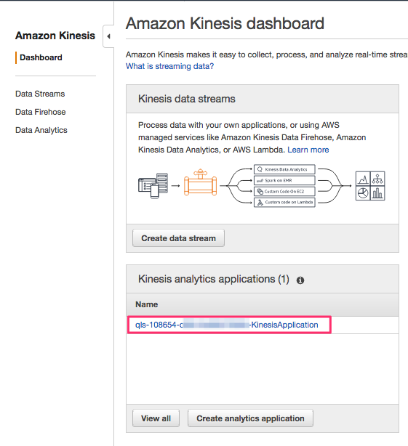
Activity 2A: Start Amazon Kinesis Data Analytics app
Navigate to the Kinesis dashboard
Click on the Kinesis Data Analytics application

Slide 44
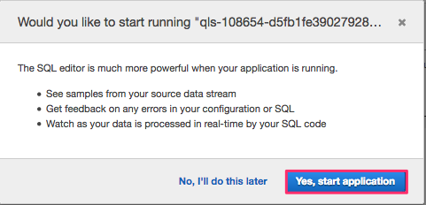
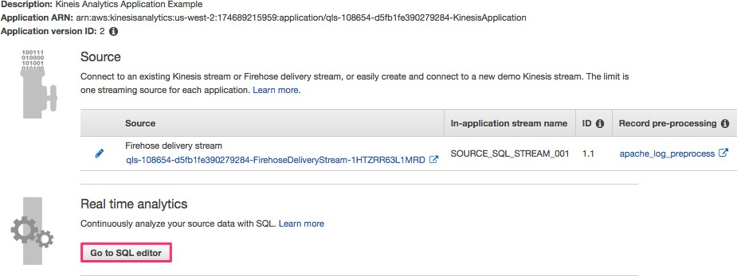
Activity 2A: Start Kinesis app
Click on “Go to SQL editor”
On the next screen, click on “Yes, start application”

Slide 45
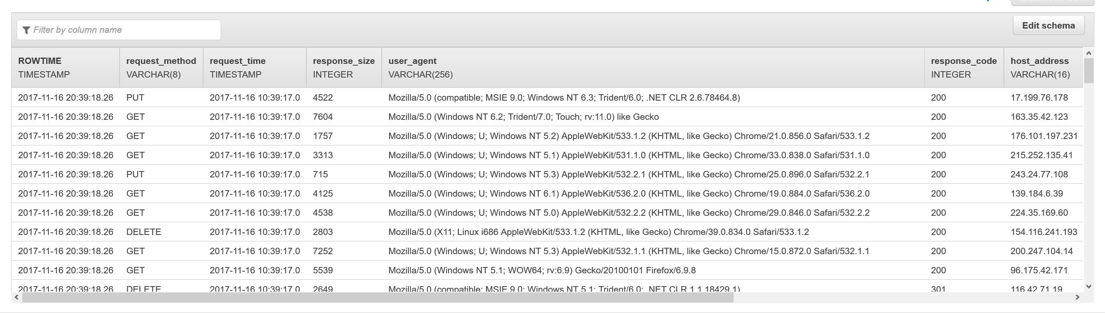
View sample records in Kinesis app
Review sample records delivered to the source stream (SOURCE_SQL_STREAM_001)

Slide 46
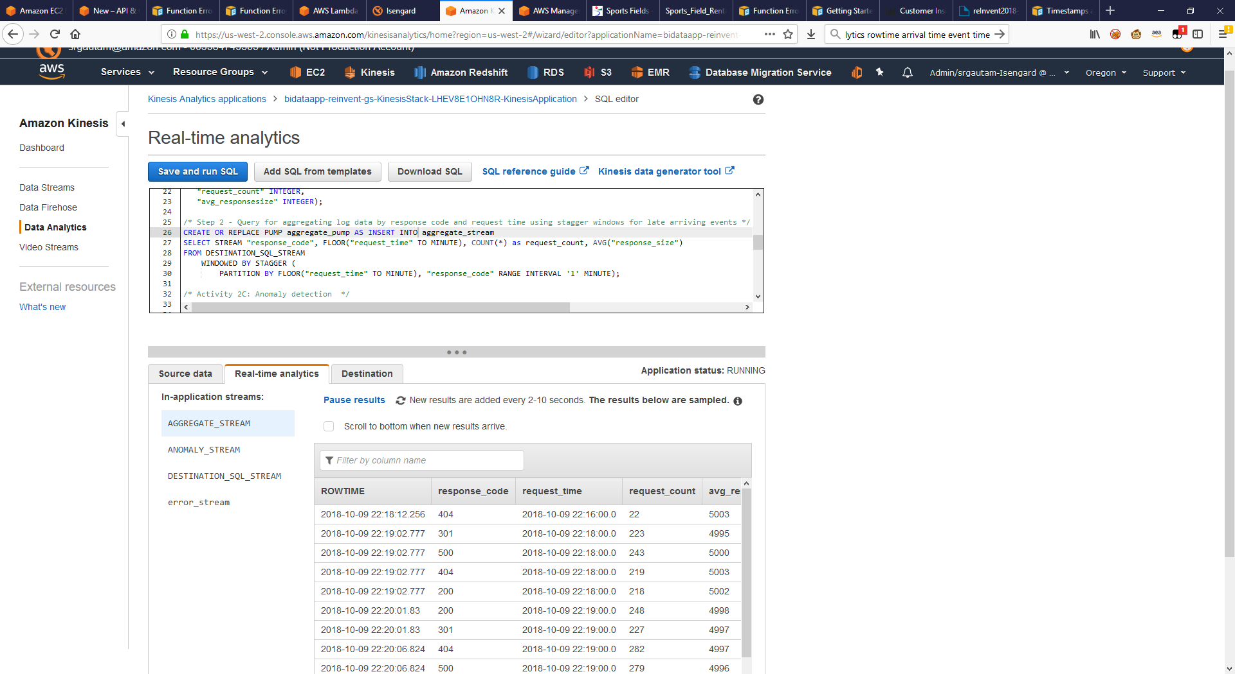
Activity 2B: Calculate an aggregate metric
Open the KinesisAnalyticsSQL file located in the Scripts section (Workshop Scripts)
Copy and paste the entire SQL in the SQL editor of your Kinesis Data Analytics application, OVERWRITING the existing text
Click “Save and run SQL”

Slide 47
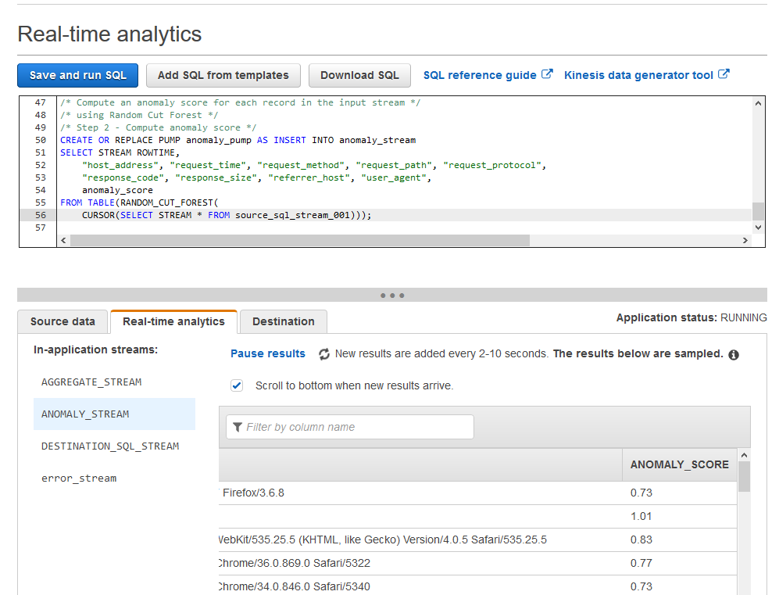
Activity 2C: Anomaly detection
Take a look at the anomaly detection section in the SQL script:
It creates an anomaly_stream with the attribute anomaly_score
It calculates the anomaly score for each record in the stream by using the built-in random cut forest function

Slide 48
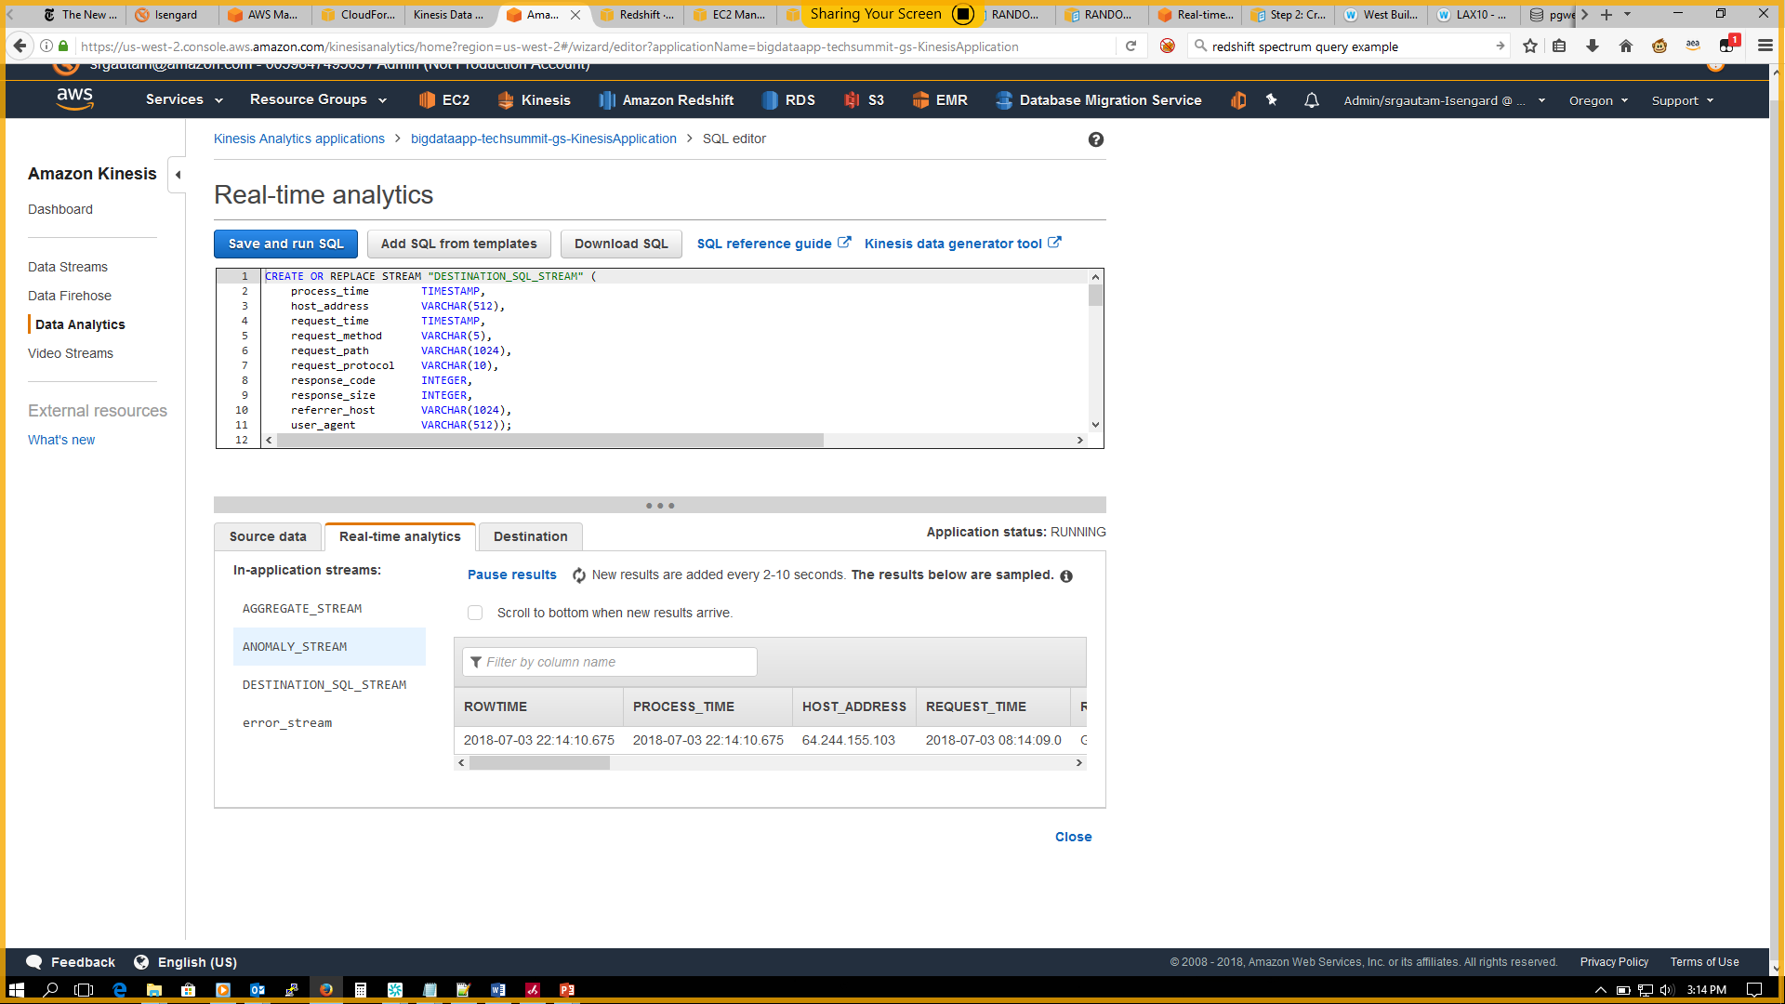
Kinesis Data Analytics in-application streams
In-application streams:
Aggregate stream
Anomaly stream
Destination SQL stream
Error stream

Slide 49
Activity 3 Deliver streaming results to Amazon Redshift

Slide 50
Your application architecture
Process & compute aggregate web log metrics
Deliver processed web logs to Amazon Redshift
Run SQL queries on processed weblogs
Visualize weblogs to discover insights
Generate weblogs
Collect weblogs and deliver to S3
Amazon Kinesis Data Analytics
Amazon Redshift
Amazon QuickSight
Amazon Kinesis Data Firehose
Amazon Athena
Kinesis Producer
Amazon Kinesis Data Firehose
Amazon S3 bucket
AWS Glue
Amazon S3 bucket
Interactive querying of weblogs
Raw weblogs from Kinesis Data Firehose
Extract metadata, create tables and transform weblogs from CSV to parquet
Transformed weblogs from AWS Glue
Amazon EMR
Interactive analysis of weblogs

Slide 51
Activity 3: Deliver data to Amazon Redshift using Kinesis Data Firehose
Time: 5 minutes
We are going to:
Connect to Amazon Redshift cluster and create a table to hold web logs data
Update Kinesis Data Analytics application to send data to Amazon Redshift, via the Data Firehose delivery stream

Slide 52
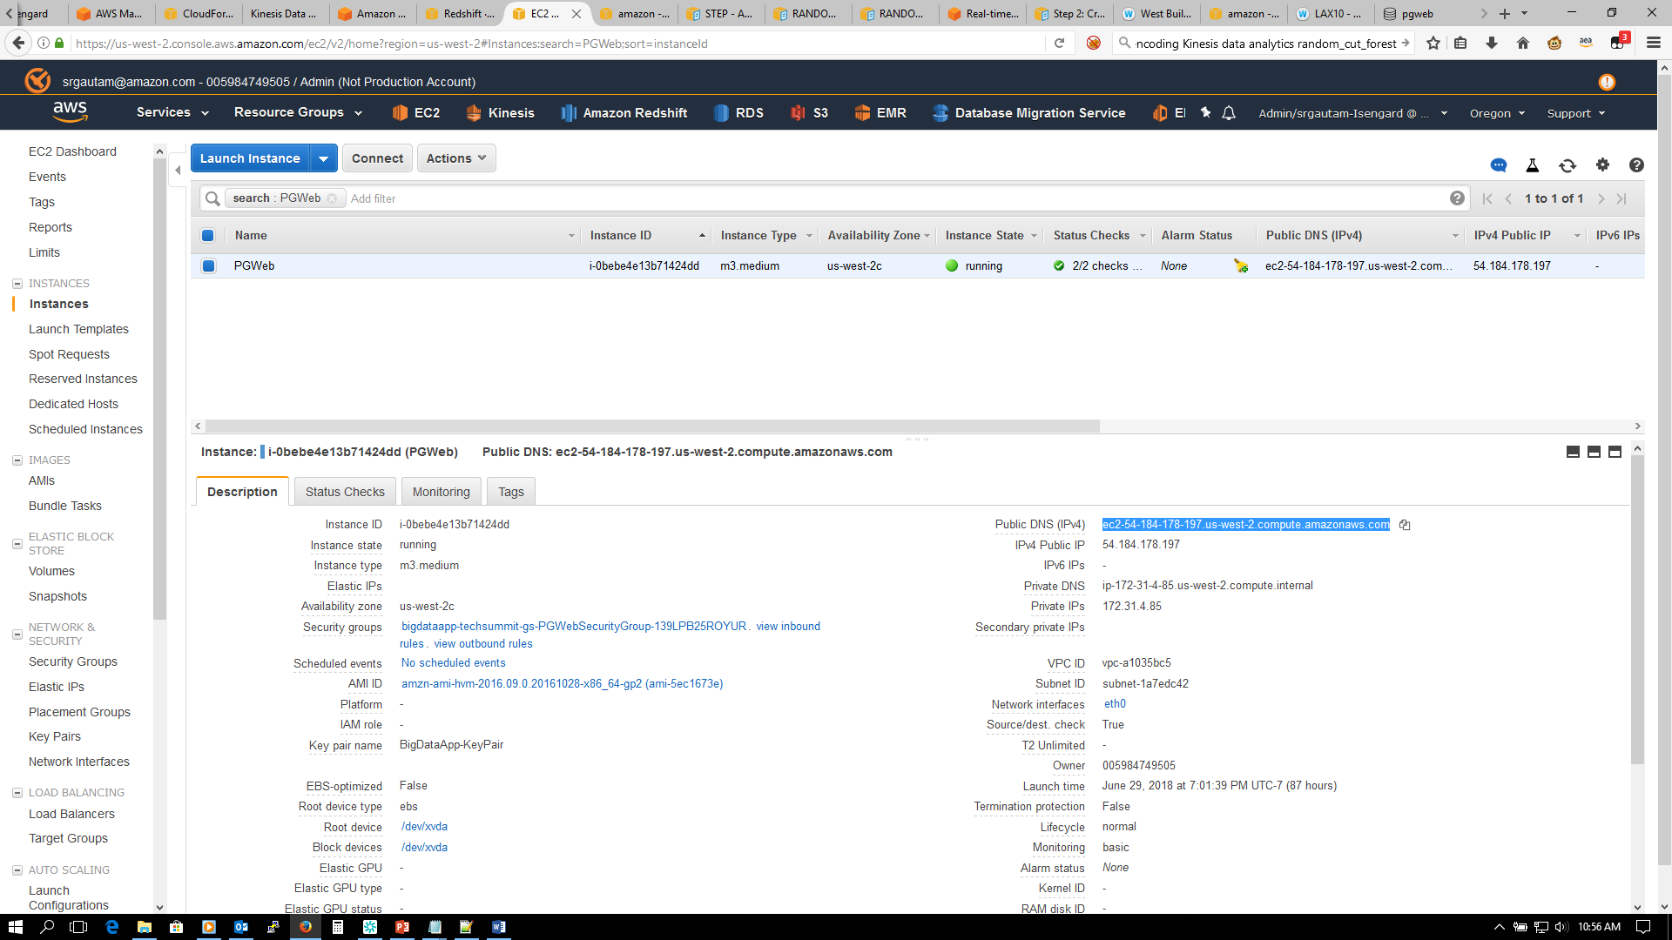
Activity 3A: Connect to Amazon Redshift
You can connect with pgweb
Already installed for the Amazon Redshift cluster
Just navigate to pgweb: Services> EC2> Select the pgweb instance> Copy the Public DNS (IPv4)> Paste in your browser> Start interacting with pgweb
Or, use any JDBC/ODBC/libpq client
Aginity Workbench for Amazon Redshift
SQL Workbench/J
DBeaver
Datagrip
If you use the above SQL clients, the username/password is in AWS CloudFormation
Select the big data CFN template and go to the Outputs tab
You will find the Amazon Redshift cluster end point, username, and password

Slide 53
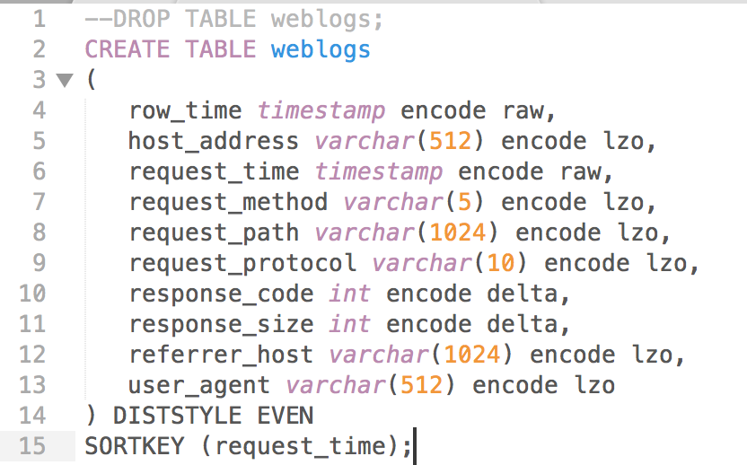
Activity 3B: Create table in Amazon Redshift
Make sure you are in the logs database in pgweb
Create table weblogs to capture incoming data from Kinesis Data Firehose delivery stream
Use RedshiftSQL.txt from Workshop Scripts for the CREATE TABLE statement
Paste in the CREATE TABLE SQL statement and click “Run Query” to create the Redshift table

Slide 54
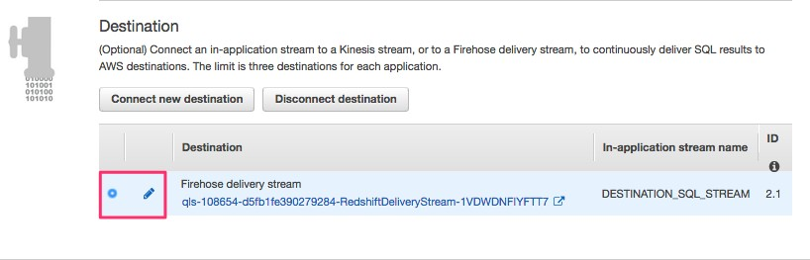
Activity 3C: Deliver data to Amazon Redshift using Data Firehose
Update Kinesis Data Analytics application to send data to Kinesis Data Firehose delivery stream. Data Firehose delivers the streaming data to Amazon Redshift.
Go to the Kinesis Data Analytics console. Go to Application Details.
Choose the Amazon Redshift delivery stream as destination and click on the edit button (see the pencil icon in the figure below).

Slide 55
Activity 3C: Deliver data to Amazon Redshift using Data Firehose
Validate your destination
Validate that the Kinesis Data Firehose stream is “<stackName>RedshiftStack-xxx-RedshiftDeliveryStream-xxxxxxxx”
Keep the default for “Choose an existing in-application stream”. DESTINATION_SQL_STREAM
Make sure CSV is the “Output format”
Validate that “Choose from IAM roles that Kinesis Data Analytics can assume”
Click “Save and continue”
It will take about 1–2 minutes for everything to be updated and for data to start appearing in Amazon Redshift

Slide 56
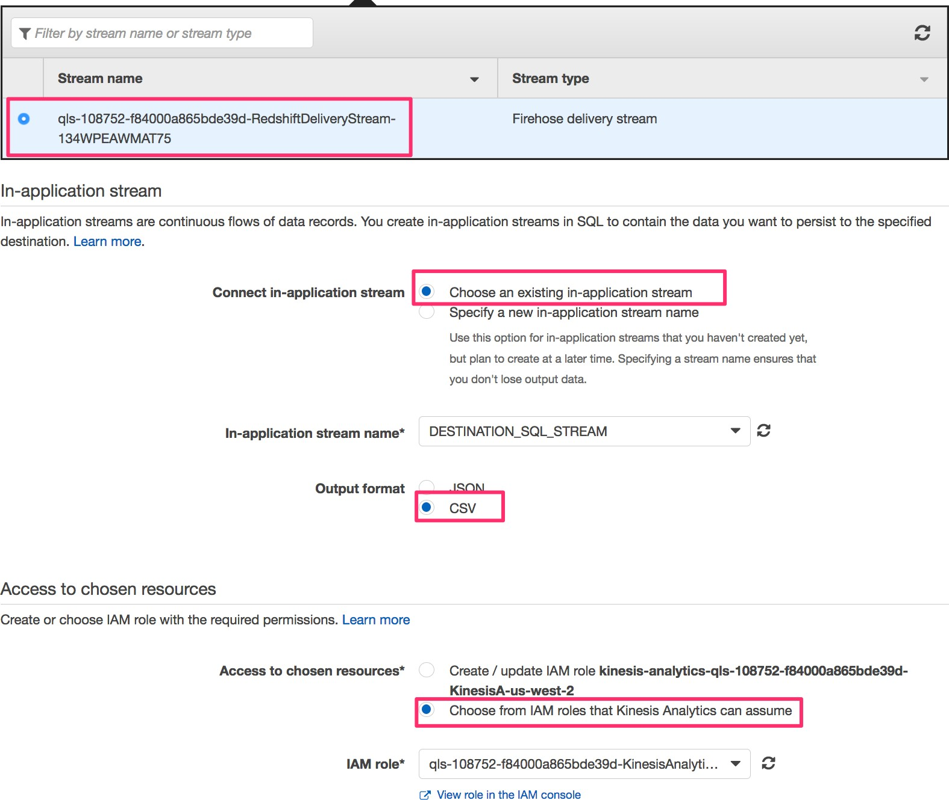
Activity 3C: Deliver data to Amazon Redshift using Data Firehose

Slide 57
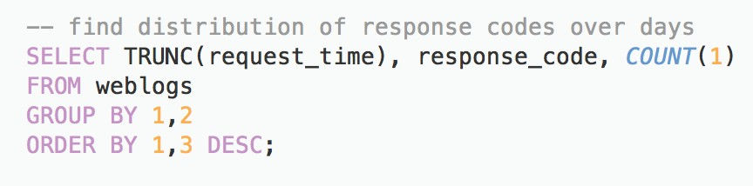
Review: Amazon Redshift test queries
Find distribution of response codes over days (copy SQL from RedshiftSQL file
Count the number of 404 response codes

Slide 58
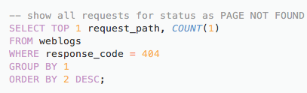
Review: Amazon Redshift test queries
Show all requests paths with status “PAGE NOT FOUND"

Slide 59
Activity 4 Transform weblogs to parquet format using AWS Glue

Slide 60
Your application architecture
Process & compute aggregate web log metrics
Deliver processed web logs to Amazon Redshift
Run SQL queries on processed weblogs
Visualize weblogs to discover insights
Generate weblogs
Collect weblogs and deliver to S3
Amazon Kinesis Data Analytics
Amazon Redshift
Amazon QuickSight
Amazon Kinesis Data Firehose
Amazon Athena
Kinesis Producer
Amazon Kinesis Data Firehose
Amazon S3 bucket
AWS Glue
Amazon S3 bucket
Interactive querying of weblogs
Raw weblogs from Kinesis Data Firehose
Extract metadata, create tables and transform weblogs from CSV to parquet
Transformed weblogs from AWS Glue
Amazon EMR
Interactive analysis of weblogs

Slide 61
Activity: Catalog and perform ETL on weblogs
Time: 30 minutes
We are going to:
Discover and catalog the weblog data deposited into the S3 bucket using AWS Glue crawler
Transform weblogs to parquet format using the AWS Glue ETL job authoring tool

Slide 62
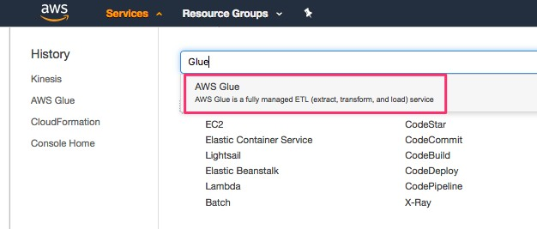
Activity 4A: Discover dataset with AWS Glue
We use AWS GLUE’s crawler to extract data and metadata. From the AWS Management Console, select AWS Glue. Click on “Get Started” on the next screen.

Slide 63
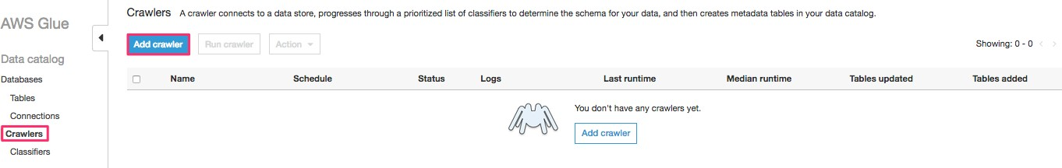
Activity 4A: Add crawler using AWS Glue
Select "Crawlers" section on the left and click on "Add crawler"

Slide 64
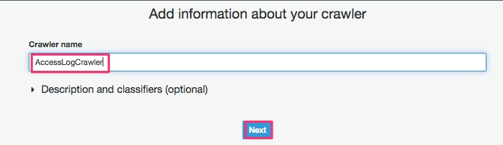
Activity 4A: ETL with AWS Glue
Specify a name for the crawler. Click "Next"

Slide 65
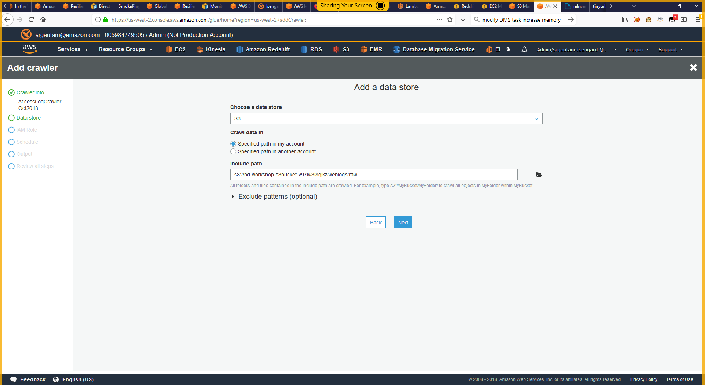
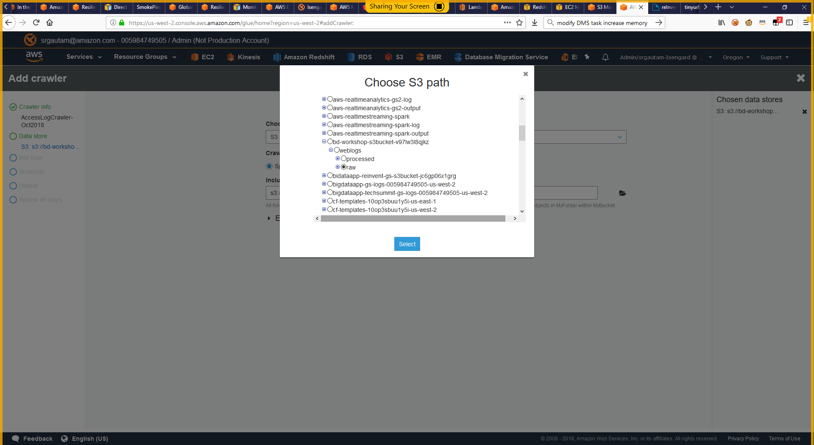
Activity 4A: ETL with AWS Glue
Provide S3 path location where the raw weblogs were placed (navigate to S3 path: s3://<S3 bucket from template>/weblogs/raw)
Click ”Next"

Slide 66
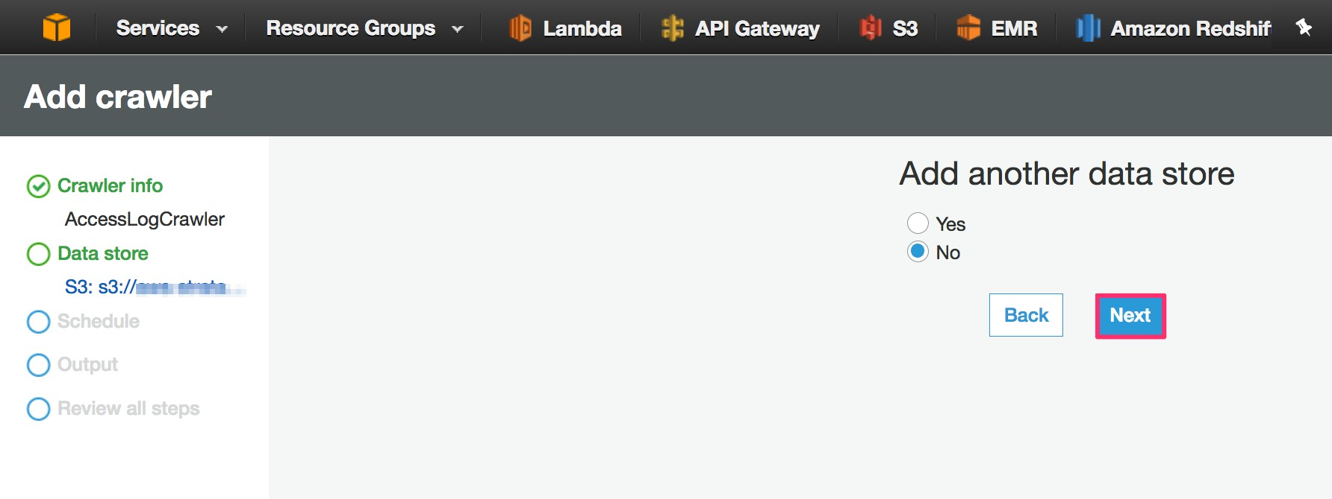
Activity 4A: ETL with AWS Glue
Click "Next" on the next screen to not add another data store

Slide 67
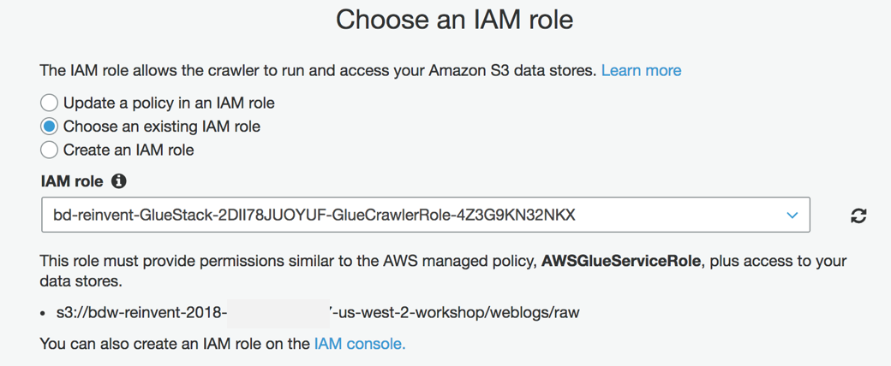
Activity 4A: ETL with AWS Glue
In the IAM role section, select “Choose an existing IAM role”
Select role <StackName>-GlueStack-xxx-GlueCrawlerRole-xxxxxxx as the IAM role and click “Next”

Slide 68
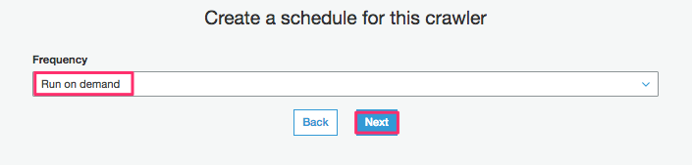
Activity 4A: Add crawler with AWS Glue
Choose "Run on demand" to run the crawler now, and click "Next"

Slide 69
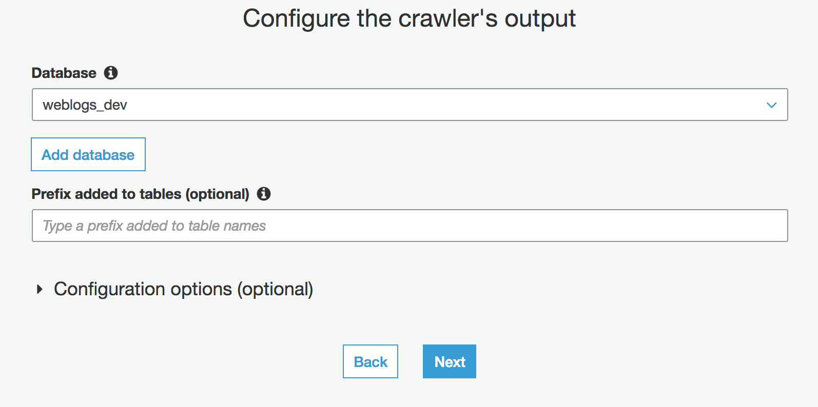
Activity 4A: Add crawler with AWS Glue
On the next screen, drop down Database and select “weblogs_dev”
Click “Next”

Slide 70
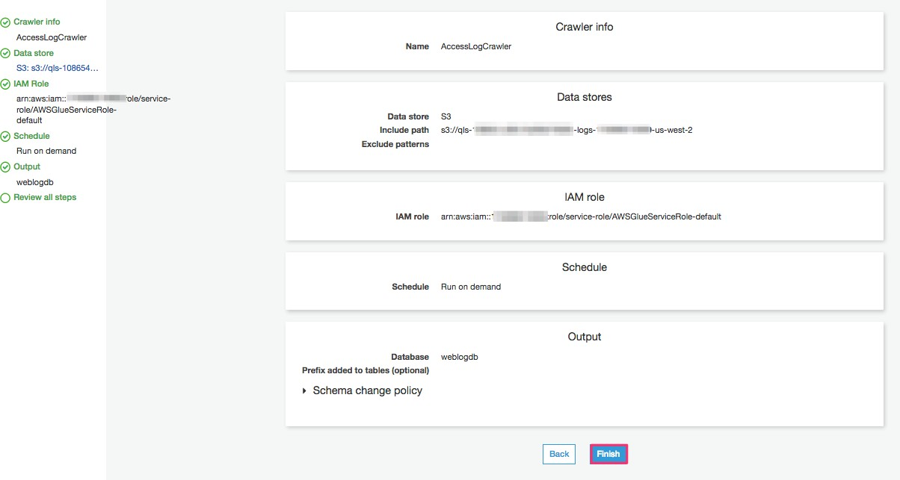
Activity 4A: Add crawler with AWS Glue
Review and click "Finish" to create a crawler

Slide 71
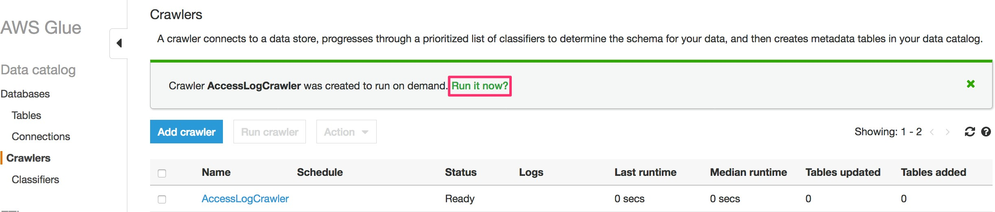
Activity 4A: Add crawler with AWS Glue
Click on "Run it now?" link to run the crawler

Slide 72
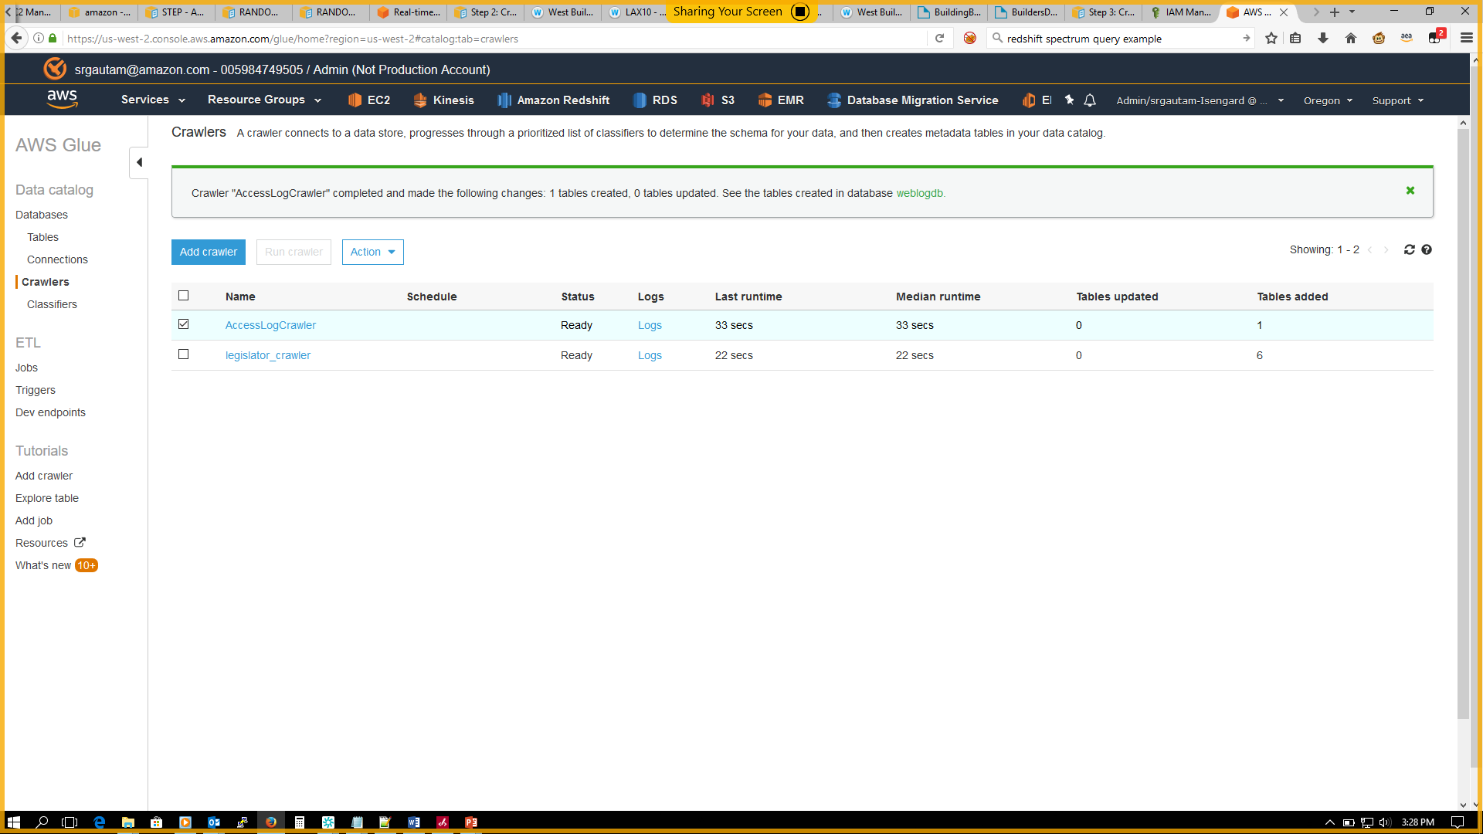
Activity 4A: Add crawler with AWS Glue
Crawler shows a Ready status when it is finished running

Slide 73
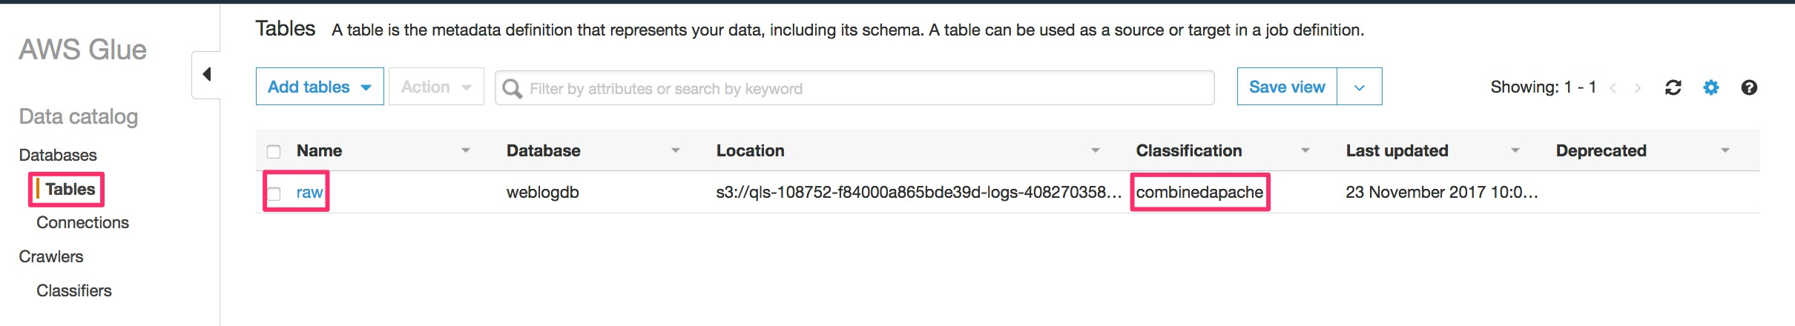
Activity 4A: Table creation in AWS Glue
Observe that the crawler has created a table for your dataset
The crawler automatically classified the dataset as combinedapache log format
Click the table to take a look at the properties

Slide 74
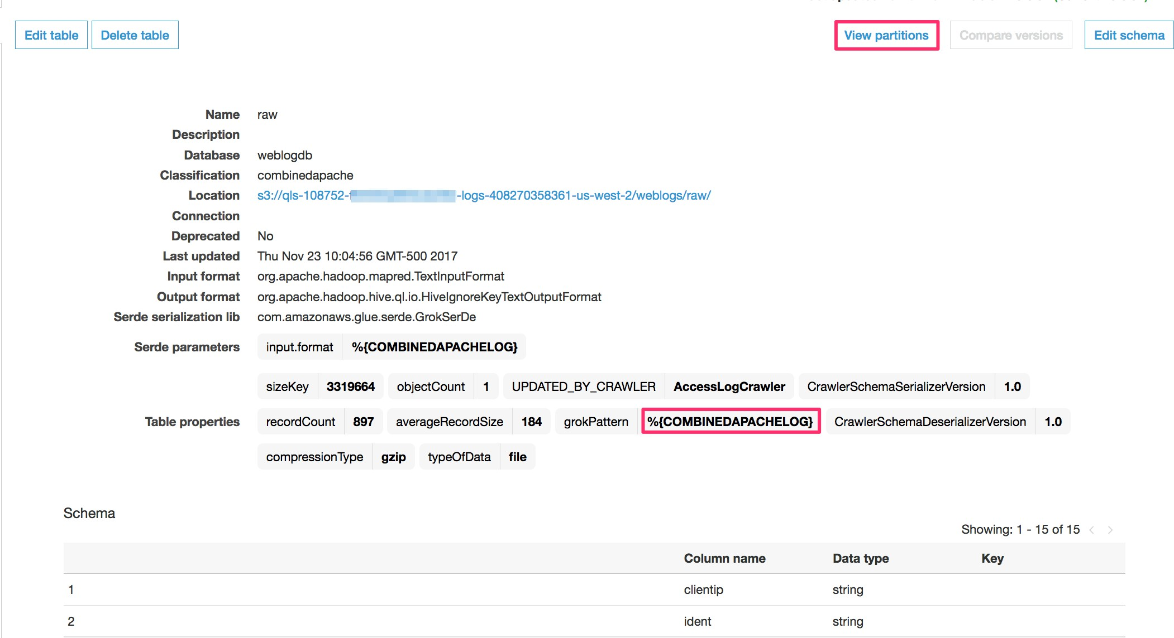
Activity 4A: Table creation in AWS Glue
AWS Glue used the GrokSerDe (Serializer/Deserializer) to correctly interpret the weblogs
You can click on the "View partitions" link to look at the partitions in the dataset

Slide 75
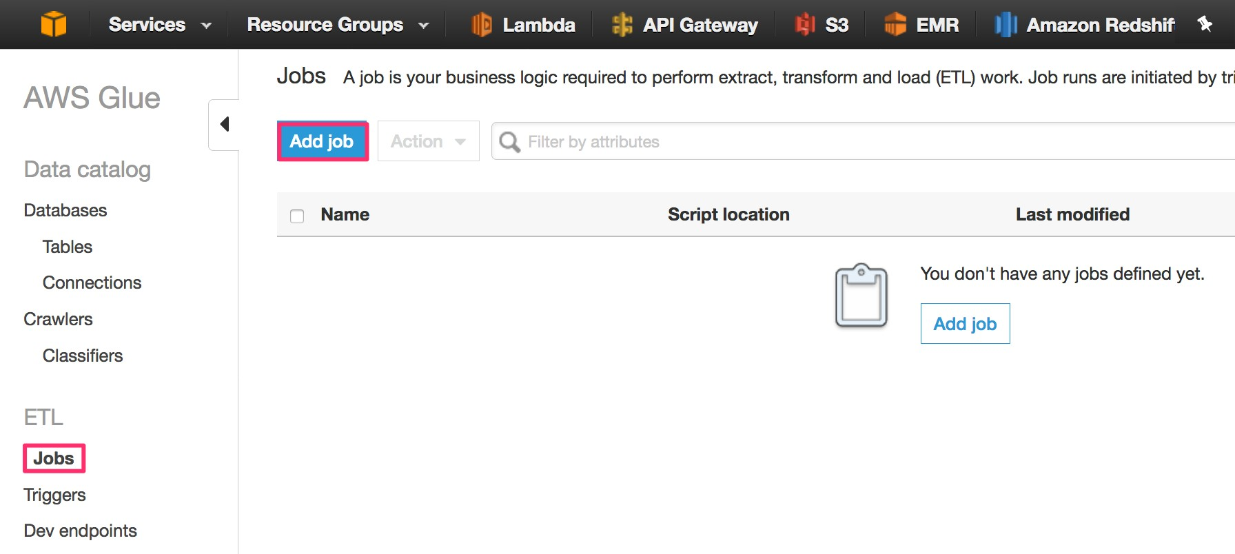
Activity 4A: Create ETL job in AWS Glue
With the dataset cataloged and table created, we are now ready to convert the weblogs–based Apache combined log format to a more optimal parquet format for querying.
Click on "Add job" to begin creating the ETL job

Slide 76
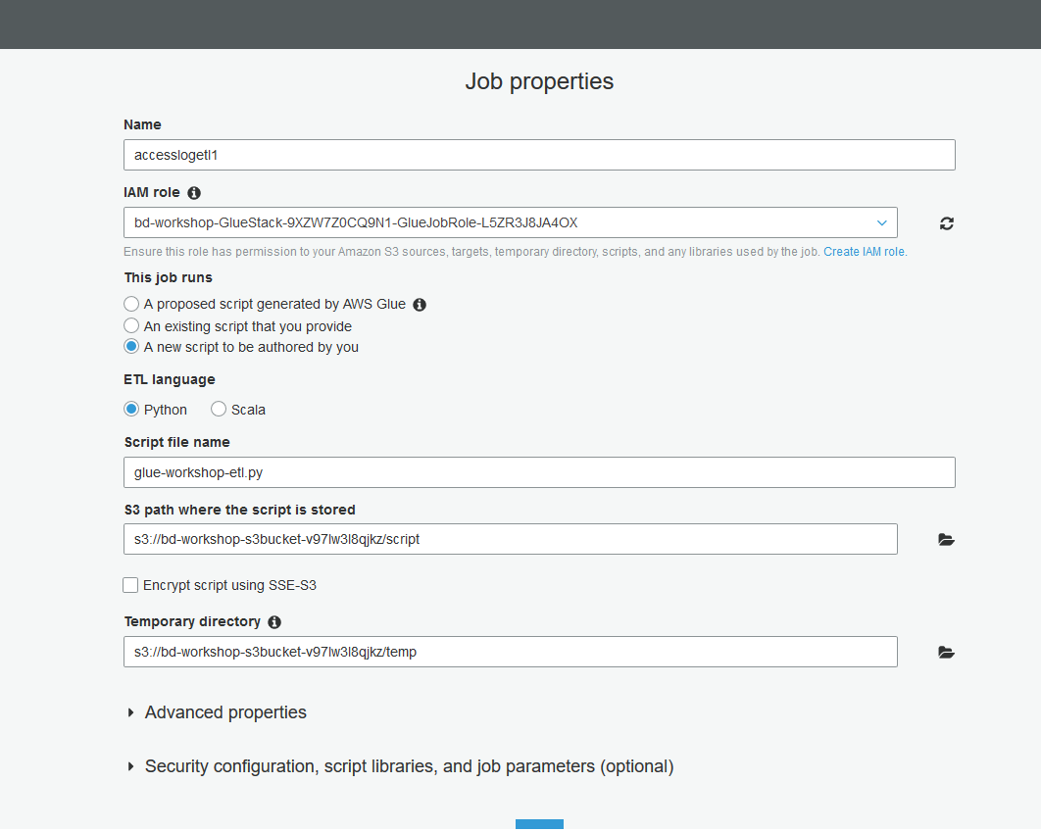
Activity 4B: ETL job in AWS Glue
Job name: accesslogetl1
Select the IAM role <StackName>-GlueStack-xxx-GlueJobRole-xxxxxxx
Select a new script to be authored by you
Select language as Python shell
Script file name: glue-workshop-etl.py
For the S3 path where the script will be stored, use path s3://<S3 bucket from template>/script
For the Temporary Directory, use path s3://<S3 bucket from template>/temp
DO NOT CLICK NEXT JUST YET

Slide 77
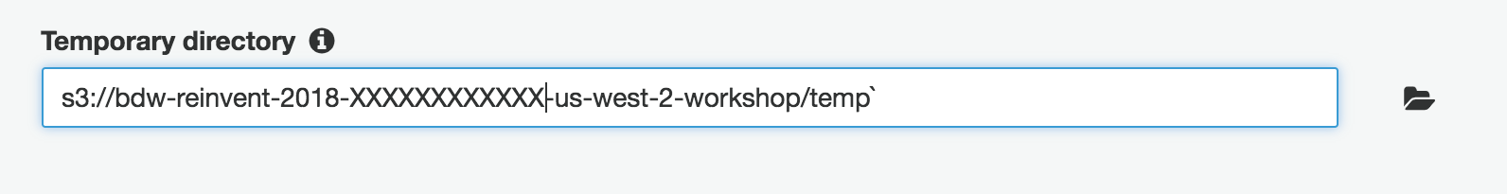
Activity 4B: ETL Job in AWS Glue
Copy the temporary path to a text editor, modify the path as follows, and save it in a file (we will need this path for storing parquet files)
Update s3://bd-workshop-s3bucket-xxxxxxxxxxxx/temp to
s3://bd-workshop-s3bucket-xxxxxxxxxx/weblogs/parquet (save in notepad)

Slide 78
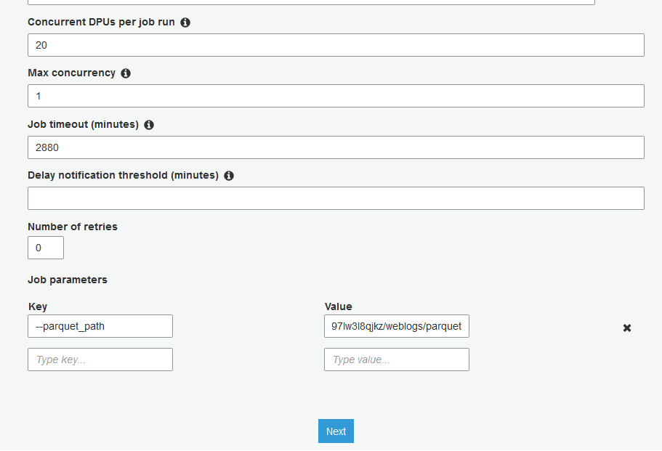
Activity 4B: ETL job in AWS Glue
Expand Script libraries and job parameters section, and increase the DPUs to 20
Let’s pass a job parameter to send the S3 path where parquet files will be deposited.
Specify the following values for Key and Value
Key: --parquet_path (notice the 2 hyphens at the beginning and underscore between “parquet” and “path”)
Value: s3://<S3 bucket from template>/weblogs/parquet
Note: Value is the S3 path we stored from the previous slide

Slide 79
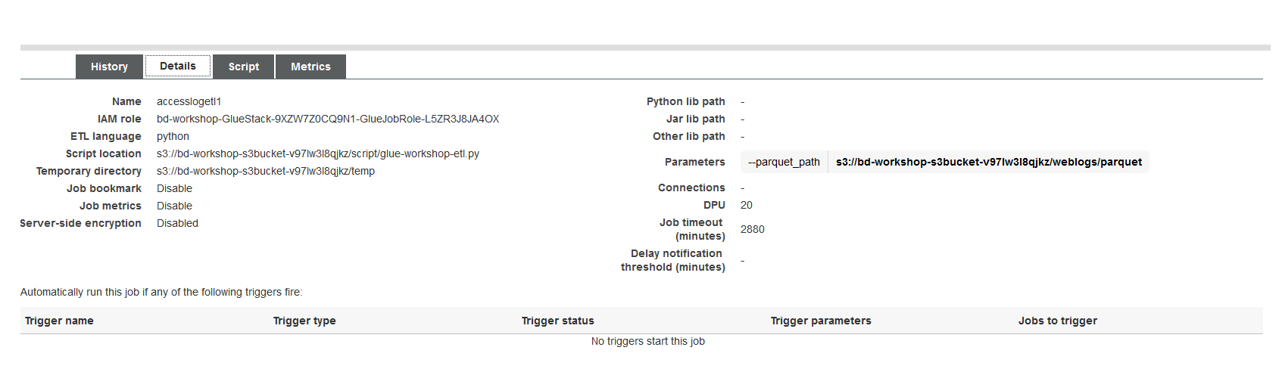
Activity 4B: ETL job in AWS Glue
Click "Next" in the following screen
Review and click "Save Job and Edit Script" to create the job

Slide 80

Activity 4B: ETL job in AWS Glue
Close script editor tips window (if it appears).
In the AWS Glue script editor, copy the ETL code in Glue-Workshop-ETL.py from BigDataWorkshop.zip and paste. Overwrite; don’t append.
Ensure that the database name (db_name) and table name reflect the database and table name created by the AWS Glue crawler.

Slide 81

Activity 4B: ETL job in AWS Glue
Click "Save" and then "Run job" button to execute your ETL

Slide 82

Activity 4B: ETL job in AWS Glue
Check that the –parquet_path is correctly set in the job parameters.
Click "Run job" to continue. This might take a few minutes. When the job finishes, weblogs will be transformed to parquet format.
Go to s3://bd-workshop-s3bucket-xxxxxxxxxx/weblogs/parquet and verify that you see parquet.snappy files in there.

Slide 83
Activity 5 Amazon Redshift Spectrum and interactive querying with Amazon Athena

Slide 84
Your application architecture
Process & compute aggregate web log metrics
Deliver processed web logs to Amazon Redshift
Run SQL queries on processed weblogs
Visualize weblogs to discover insights
Generate weblogs
Collect weblogs and deliver to S3
Amazon Kinesis Data Analytics
Amazon Redshift
Amazon QuickSight
Amazon Kinesis Data Firehose
Querying raw web logs using Amazon Redshift Spectrum
Amazon Athena
Kinesis Producer
Amazon Kinesis Data Firehose
Amazon S3 bucket
AWS Glue
Amazon S3 bucket
Interactive querying of weblogs
Raw weblogs from Data Firehose
Extract metadata, create tables and transform weblogs from CSV to parquet
Transformed weblogs from AWS Glue
Amazon EMR
Interactive analysis of weblogs

Slide 85
Activity: Querying data in Amazon S3 using Redshift Spectrum
Time: 30 minutes
We are going to:
Create a table over the processed weblogs in Amazon S3 using an AWS Glue crawler. These are the parquet files created by AWS Glue ETL job in the previous section.
Run queries from Amazon Redshift on the parquet weblogs in Amazon S3 using Amazon Redshift Spectrum.
Run interactive queries from Athena on parquet weblogs in S3.

Slide 86

Activity 5A: Set up AWS Glue crawler for processed parquet data
Go to Crawlers in AWS Glue and search for ParquetLogs.
Select the ParquetLogsCrawler-xxxxxxx. Go to details tab and check that it’s pointing to the right parquet location in Amazon S3.
Run crawler. Should take about 30 secs for the crawler to finish running.

Slide 87

Activity 5A: Set up AWS Glue crawler for processed parquet data
Navigate to Databases-Tables in AWS Glue. Search weblogs_<environment>.
Make sure you see both the “raw” and the newly created “parquet” table.

Slide 88

Activity 5A: Set up AWS Glue crawler for parquet data
Take a look at the schema of the parquet table
Should have eight columns
Classification should be parquet

Slide 89

Activity 5B: Query using Amazon Redshift Spectrum
Navigate to Amazon Redshift-Clusters. Select the cluster with the <stack-name>
Click on “Manage IAM roles”.
Validate that IAM role shows bd-workshop-RedshiftStack-xxx-RedshiftSpectrumRole-xxxxxxxxxxx.

Slide 90

Activity 5B: Query using Amazon Redshift Spectrum
Navigate to pgWeb. If you need the URL, check public IP of the pgweb EC2.
Get the RedshiftSpectrumSetup.sql from the BigDataWorkshop.zip.
Make sure you replace the role ARN with your SpectrumRole ARN.
Make sure you are pointing to the weblogs_dev database.
This will create an external schema in Amazon Redshift called “Spectrum”.

Slide 91


Activity 5B: Query using Amazon Redshift Spectrum
Let’s run a couple of simple queries against Amazon S3 from Amazon Redshift using Amazon Redshift Spectrum
Count of all records in the parquet location in Amazon S3
Select count(*) from spectrum.parquet
Count of all records in the parquet location in Amazon S3 where the response is 404
Select count(1) from spectrum.parquet where response=404;

Slide 92

Activity 5C: Querying using Amazon Athena
Go to the Athena console. Close the tutorial that comes up.
In the Athena console, choose the "weblogs_<environment>" on the database dropdown.
Select "parquet“ from the tables section and click on the three stacked dots icon to preview/sample a few rows of the S3 data.

Slide 93

Activity 5C: Querying using Amazon Athena
Athena allows you to run interactive queries against parquet data in Amazon S3
Run the queries from the AthenaSQL from the BigDataWorkshop.zip
Count of each clientIP
Count of each response code

Slide 94
Congratulations!
and
Thank you for attending !

Slide 95
Optional exercise: Data processing with
Amazon EMR

Slide 96




Amazon EMR service
Applications Hive, Pig, Spark SQL/Streaming/ML, Flink, Mahout, Sqoop |  |  |  | HBase/Phoenix | Presto | MXNet
Batch MapReduce | Interactive Tez | In memory Spark | Streaming Flink
YARN Cluster resource management
Storage Amazon S3 (EMRFS), HDFS
Ganglia—monitoring
Hue—SQL
Zeppelin—notebooks
Livy—job server
Connectors to AWS services
Amazon EMR service

Slide 97









On-cluster UIs
SQL editor, workflow designer, metastore browser
Notebooks
Manage applications
Design and execute queries and workloads
And more using bootstrap actions!

Slide 98


















The Hadoop ecosystem can run in Amazon EMR

Slide 99

Easy-to-use Amazon EC2 Spot Instances
Meet SLA at predictable cost
On-demand for core nodes
Standard Amazon Elastic Compute Cloud (Amazon EC2) pricing for on-demand capacity
Exceed SLA at lower cost
Spot Instances for task nodes
Up to 90% off Amazon EC2
on-demand pricing

Slide 100

Amazon S3 as your persistent data store
Separate compute and storage
Resize and shut down Amazon EMR clusters with no data loss
EMR
Point multiple Amazon EMR clusters at same data in Amazon S3
Amazon S3
EMR

Slide 101
EMRFS makes it easier to leverage Amazon S3
Transparent to applications—Use “s3://”
Support for Amazon S3 server-side and client-side encryption
Faster listing using EMRFS metadata
Makes it easier to secure your clusters (fine-grained access control, Kerberos, security configurations)
New feature! EMR 5.14.0+ supports the ability to audit users who ran queries that accessed data in Amazon S3 through EMRFS and pushes user/group information to audit logs like AWS CloudTrail.

Slide 102


Apache Spark
Fast, general-purpose engine for large-scale data processing
Write applications quickly in Java, Scala, or Python
Combine SQL, streaming, and complex analytics

Slide 103

Apache Zeppelin
Web-based notebook for interactive analytics
Multiple language back end
Apache Spark integration
Data visualization
Collaboration
https://zeppelin.apache.org/

Slide 104
Activity 6 Interactive analysis using
Amazon EMR

Slide 105
Your application architecture
Process & compute aggregate web log metrics
Deliver processed web logs to Amazon Redshift
Run SQL queries on processed weblogs
Visualize weblogs to discover insights
Generate weblogs
Collect weblogs and deliver to S3
Amazon Kinesis Data Analytics
Amazon Redshift
Amazon QuickSight
Amazon Kinesis Data Firehose
Amazon Athena
Kinesis Producer
Amazon Kinesis Data Firehose
Amazon S3 bucket
AWS Glue
Amazon S3 bucket
Interactive querying of weblogs
Raw weblogs from Kinesis Data Firehose
Extract metadata, create tables and transform weblogs from CSV to parquet
Transformed weblogs from AWS Glue
Amazon EMR
Interactive analysis of weblogs

Slide 106
Activity 6: Process and query data with Amazon EMR
Time: 20 minutes
We are going to:
Use a Zeppelin notebook to interact with Amazon EMR cluster
Process the data in Amazon S3 using Apache Spark
Query the data processed in the earlier stage and create simple charts

Slide 107


Activity 6A: Open the Zeppelin interface
Copy the Zeppelin end point in the AWS CloudFormation output section
Open the Zeppelin link in a new browser window
Download the First Big Data Application json file from the BigDataWorkshop.zip
Import the notebook using the "Import Note" link on Zeppelin interface
Note: Disconnect from VPN or the page will not load

Slide 108

Activity 6A: Open the Zeppelin interface
Step 1: Run the first paragraph
Enter <stackname>-logs-<account>-us-west-2/processed/parquet in the Bucket field as input
This is where the processed parquet files were stored earlier in your S3 bucket

Slide 109

Activity 6B: Run the notebook
Execute Step 2
Create a data frame with the parquet files from the AWS Glue ETL job
Execute Step 3
Sample a few rows

Slide 110

Activity 6B: Run the notebook
Execute Step 4 to process the data
Notice how the “AGENT” field consists of the “BROWSER” at the beginning of the column value. Let’s extract the browser from the agent field.
Create a UDF to extract the browser and add to the data frame
Print the new data frame

Slide 111

Activity 6B: Run the notebook
Execute Step 6
Register the data frame as a temporary table
Now you can run SQL queries on the temporary tables
Execute the next 3 steps and observe the charts created
What did you learn about the data set?

Slide 112
Review: Interactive analysis using Amazon EMR
You just learned on how to process and query data using Amazon EMR with Apache Spark
Amazon EMR has many other frameworks available for you to use
Hive, Presto, Flink, Pig, MapReduce
Hue, Oozie, HBase

Slide 113
Optional exercise: Data visualization with
Amazon QuickSight

Slide 114



Amazon QuickSight
Fast, easy interactive analytics for anyone, everywhere
Ease of use targeted at business users
Blazing-fast performance powered by SPICE
Broad connectivity with AWS data services, on-premises data, files, and business applications
Cloud-native solution that scales automatically
1/10th the cost of traditional BI solutions
Create, share, and collaborate with anyone in your organization, on the web, or on mobile

Slide 115



















Connect, SPICE, analyze
Amazon QuickSight allows you to connect to data from a wide variety of AWS, third-party, and on-premises sources and import it to SPICE or query directly
Users can then easily explore, analyze, and share their insights with anyone
Amazon RDS
Amazon Redshift
Amazon S3

Slide 116
Activity 7 Visualize results in
Amazon QuickSight

Slide 117
Your application architecture
Process & compute aggregate web log metrics
Deliver processed web logs to Amazon Redshift
Run SQL queries on processed weblogs
Visualize weblogs to discover insights
Generate weblogs
Collect weblogs and deliver to S3
Amazon Kinesis Analytics
Amazon Redshift
Amazon QuickSight
Amazon Kinesis Firehose
Amazon Athena
Kinesis Producer
Amazon Kinesis Firehose
Amazon S3 bucket
AWS Glue
Amazon S3 bucket
Interactive querying of weblogs
Raw weblogs from Kinesis Data Firehose
Extract metadata, create tables and transform weblogs from CSV to Parquet
Transformed weblogs from AWS Glue
Amazon EMR
Interactive analysis of weblogs

Slide 118
Activity 7: Visualization with Amazon QuickSight
Time: 10 mins
We are going to:
Register for an Amazon QuickSight account
Connect to the Amazon Redshift cluster
Create visualizations for analysis to answer questions like:
What are the most common http requests and how successful (response code of 200) are they?
Which are the most requested URIs?

Slide 119


Activity 7A: Amazon QuickSight registration
Go to AWS console, click on Amazon QuickSight from the analytics section
Click on "Sign up" in the next window
Make sure the subscription type is standard and click "Continue" on the next screen

Slide 120

Activity 7A: Amazon QuickSight registration
On the "Subscription type" page, enter the account name (see note below)
Enter your email address
Select US West region
Check the "Amazon S3 (all buckets)" box
Note: Amazon QuickSight account name is your AWS account number

Slide 121



Activity 7A: Amazon QuickSight registration
If a popup box to choose Amazon S3 buckets appears, click "Select buckets"
Click on "Go to Amazon QuickSight"
Dismiss welcome screen
Make sure you are in us-west-2 (Oregon)

Slide 122

Activity 7B: Connect to data source
Click on "Manage Data" and then select "New Data set" to create a new data set in Amazon QuickSight.
Choose "Redshift (Auto-discovered)" as the data source. Amazon QuickSight auto-discovers databases associated with your AWS account (Amazon Redshift database in this case).

Slide 123

Activity 7B: Connect to Amazon Redshift
Note: Use ”dbadmin” as the username. You can get the Amazon Redshift database password by navigating to the AWS CloudFormation outputs section.

Slide 124

Activity 7C: Choose your weblogs Amazon Redshift table
Select “public” schema
Select “weblogs” in tables

Slide 125

Activity 7D: Ingest data into SPICE
SPICE is Amazon QuickSight's in-memory optimized calculation engine, designed specifically for fast, interactive data visualization
You can improve the performance of database data sets by importing the data into SPICE instead of using a direct query to the database

Slide 126

Activity 7E: Creating your first analysis
What are the most requested http request types and their corresponding response codes for this site?
Simply select request, response, and let AUTOGRAPH create the optimal visualization

Slide 127


Review - Creating your analysis
Exercise: Add a visual to demonstrate which URI are the most requested

